Slide 1
Preparing for your online interview with South Dublin County Council
Notes:
Thank you for choosing to apply with us at South Dublin County Council.

Slide 2
Online Interviews
This video was prepared, in line with national guidance from the Local Government Management Agency, to help candidates in preparation for their online interview with South Dublin County Council.
Interviews will be via Microsoft Teams. Once connected, you will be able to see and speak with the interviewers on screen.
The following slides will help you prepare for the interview.
Notes:
This resource has been prepared in line with national guidance from the Local Government Management Agency to help you prepare for your upcoming interview.
Online interviews are similar to in-person or phone interviews. Like those, preparation is key.

Slide 3
Be Prepared
Internet Connection
You will need an internet connection with at least 1MB per second bandwidth. Close all other applications.
Camera
You will need a computer, tablet or mobile device with a camera. Please test in advance your camera is working.
Headphones
If possible wear headphones with a built-in microphone. Please test in advance your microphones and headphones are working.
Devices
Turn off all other devices in the room to avoid disruption or electronic feedback. Do not text or email during the interview.
Notes:
In advance of your interview, make sure you are prepared. Do a tech check in advance on your internet connection, headphones and camera to make sure they are all in working order.
Don’t forget to turn off all other devices in the room and close all applications other than Microsoft Teams on your PC, tablet or phone.

Slide 4
Be Prepared – Setting Up
Position the camera so you’re looking up slightly. Ensure your head and shoulders are seen on the screen. Use a stack of books if you need to.
Check the lighting and what is in your background. Position a lamp in front of you.
Can you see yourself on the screen? If you can’t, neither can the interview board.
Notes:
Give yourself enough time before the interview to get set up. Position your camera so your head and shoulders are seen. Check the lighting in the room. If you need more lighting, position a lamp in front of you.
Can you see yourself on screen? If you cannot, neither can the interview board.

Slide 5
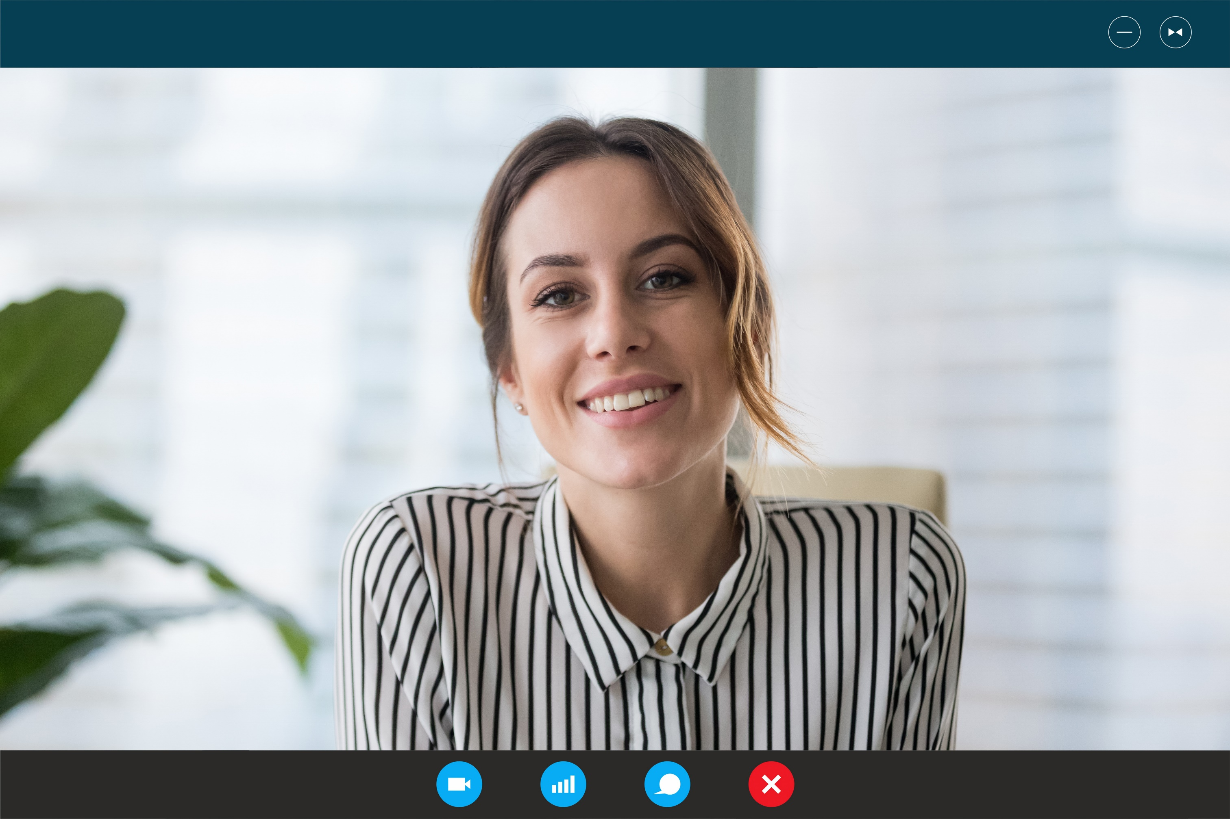
Centre Your
Screen
This is an example of what the interview board will see if you’re positioned correctly.
Notes:
This is an example of what the interview board should see once you’ve carried out your checks.

Slide 6
Be Prepared – Your Area
Peace and Quiet
Select somewhere quiet, private and well lit where you won’t be interrupted. Put your phone on silent.
Water
Don’t forget to pour yourself a glass of water before the interview.
Be Punctual
You should log in to Microsoft Teams at least ten minutes in advance to avoid delays and check sound, camera and backgrounds.
Recording
The interview will not be recorded. You are not permitted to record the interview. You should not use the mute function during the interview.
Notes:
Make sure to use a room where you will not be disturbed.
Pour yourself a glass of water and have it ready for the interview. Log on to Microsoft Teams at least ten minutes in advance to make sure everything is okay.
The interview board will not record the interview and you are not permitted to either.

Slide 7
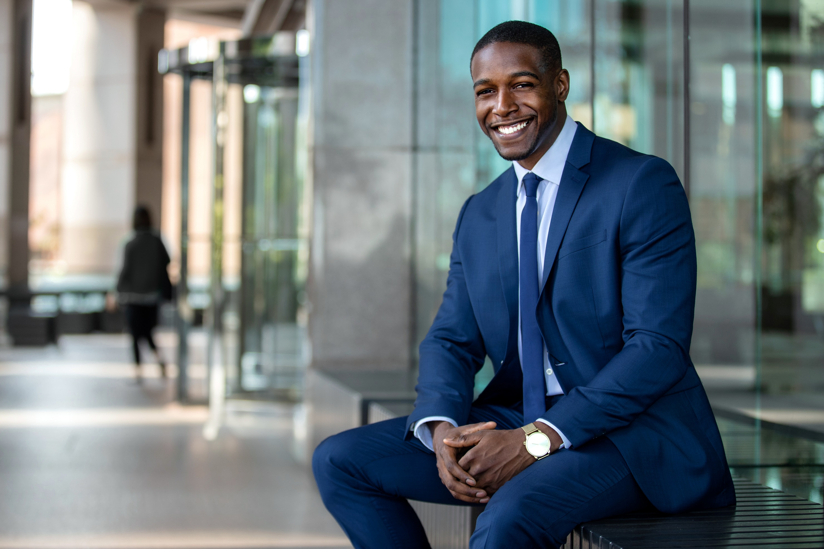
Dress Professionally
Dress how you would for an in-person interview.
Be mindful that screen cameras often don’t portray bright colours and patterns very well.
Notes:
Remember to dress how you would if you were attending an in-person interview.
First impressions matter.
Be aware however that bright colours and patterns often do not look well on camera.

Slide 8
Be Prepared – Checklist
Tech Setup
Camera Position
Lighting and Background
Water
Private Space
Dress Professionally
Notes:
You might find this checklist useful in advance of your interview.
Go through each one and ensure you are fully prepared.

Slide 9
The Online Interview
The interview board will log into the meeting at your allocated interview time.
Be patient, this may take a few moments, don’t panic.
The Chairperson will …
confirm your identity
introduce the board members and the format of the interview
confirm that everyone can see and hear each other
formally start and end interview
Notes:
The interview board will log into the meeting at the correct interview time.
Be patient.
This may take a few moments but don’t panic. You’ve done the work for this interview and are more than ready.
Each interview has a chair person who will introduce the board to you and go through the format of the interview.
They will be the person who formally starts and ends the interview.

Slide 10
Answering Questions
Look at the Camera
Speak Clearly
Eye contact in an in-person interview is very important and difficult to achieve the same connection via video.
Don’t be afraid to look at the camera when speaking. Your eyes are more likely to align with the interviewers on the other end.
When listening, look at the screen or the camera.
Make sure your speaker isn’t on mute. You should not use the mute option during the interview.
Speak clearly and slowly at a regular volume.
Take into account there may be a slight time delay, wait for the interviewer to finish asking the question before answering.
If at anytime during the interview you cannot hear the interviewer, you should interrupt and advise them immediately.
Notes:
During the interview, remember to look directly at the camera.
Speak clearly.
Speak slowly.
And at a regular volume.
Always wait for the interviewer to finish asking their question before answering. If you need a moment to answer, a good tip is to take a drink of water before speaking to compose yourself.

Slide 11
Your Invitation to Interview
Your invitation to attend for interview will include the “Join Microsoft Teams link” – example below
Join Microsoft Teams Meeting
+353 1 592 0938 Ireland, Dublin (Toll)
Conference ID: 622 056 342#
Should you experience any technical difficulties connecting to your interview or during your interview, you should notify the Interview Board directly by contacting them at your allocated interview time via telephone by dialling the number (beneath the link) and entering your conference ID number below.
The Board will then notify a member of the Recruitment Section who will then contact
you. Please note, interviews will not be conducted via telephone.
Notes:
Your invitation to interview will include a link as shown on the screen.
Should you experience any technical difficulties, follow the steps also shown here.

Slide 12
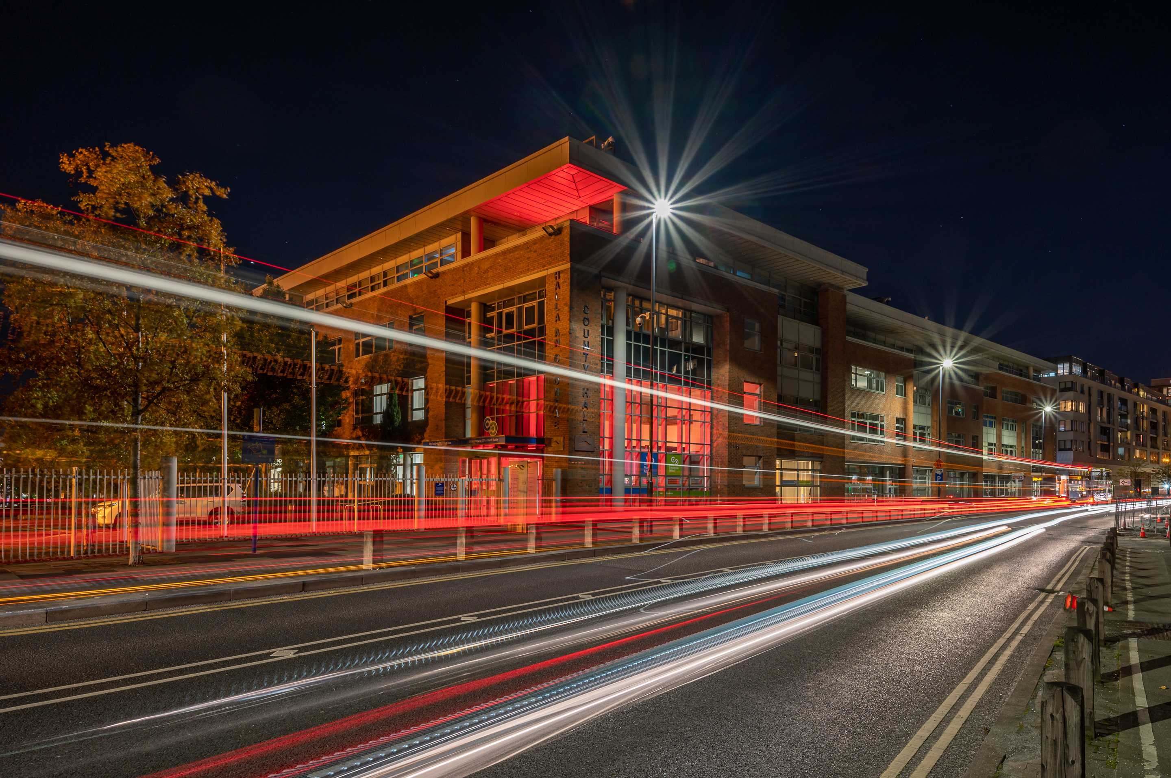
Thank you for applying to work with us in South Dublin County Council
Notes:
Thank you once again for applying to work with us here at South Dublin County Council.
If you are looking for more info on the Council, check out www.sdcc.ie.

