Slide 1

The impact of social exclusion
Paula Haverty

Slide 2
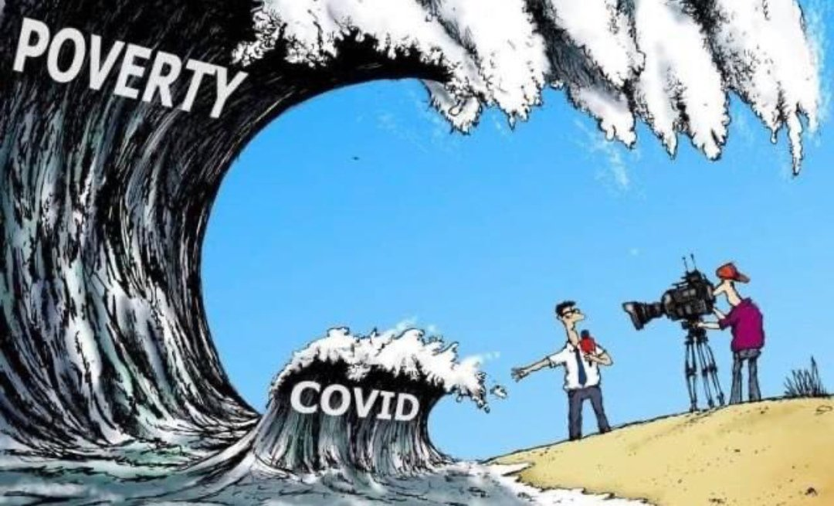

Slide 3
The perspective I bring
I live in an area that experiences high levels of deprivation
I live in Balgaddy in North Clondalkin, but there are similar circumstances in Jobstown, Killinarden and other parts of the county
I am involved in community development activity to bring about changes to the situation that we experience - just as others are in other parts of the county
I am conscious that it’s difficult to convey what social exclusion is to those who have no such experience ….. but I will try!

Slide 4
Social exclusion has a material basis
In Killinarden 7% of the population have 3rd level qualifications. The National figure is 42%
Many live on welfare or minimum wage and experience material deprivation – lack of warm clothes, a night out with friends, nutritious food, a holiday
Housing may be of poor standard, in need of refurbishment. An emergency is a disaster – likely to result in rent arrears and extreme poverty
Covid impacted most severely on these disadvantaged areas. While everybody suffered, poorer families took a lot of the burden

Slide 5
… and a psychological dimension
Mental health – depression, high suicide rate (3 times the national rate in a recent study)
Alienation- restricted social networks, lack of meaningful participation in society
Overuse of drugs and alcohol to maintain a level of functioning
High levels of crime and drug use – constant concern that your child will succumb

Slide 6
What we need
We need to be heard, to matter, to be regarded
  We need a voice in planning and decision making, through our groups and structures
  To be part of the solution – we know the problems and the solutions
  To be part of estate management solutions, to be a stakeholder not just a tenant
Need investment in infrastructure and services
  We deserve it. There are huge social needs need to be responded to
  In particular we need investment in community development so we can build community and foster ownership

Slide 7
What the LCDC can do
Develop a clear understanding of what social exclusion is. We know what it is. We live with it. Involve us
Develop a social inclusion strategy to turn deprived and disadvantaged areas around. Local authorities may not have the budgets to do this but they can at least put down a roadmap for wider state investment
An education strategy - disadvantaged areas are not benefitting from education. 3rd level participation should be much higher
Community development is the key to social change – it empowers communities to lead out on social inclusion, to lay the foundation for greater equality and better life chances for families and children

