Slide 1

South Dublin County Council
Audio is provided on each slide.
To listen hover the cursor over the speaker symbol in the centre of each slide, a bar will appear, click on the triangle to play the narrative.
Monastery Road Walking and Cycling Scheme
July 2020

Slide 2

South Dublin County Council
Monastery Road Walking and Cycling Scheme

Slide 3

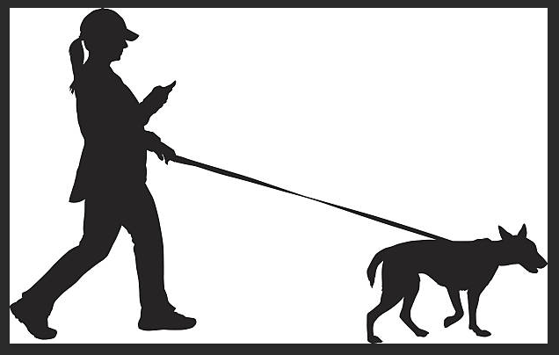
Cycle South Dublin
South Dublin County Council is committed to providing robust walking and cycling infrastructure within our County
The Council is preparing an ambitious programme of walking and cycling projects across the County to be agreed by Council in the autumn and delivered over the coming 5years
The Council wants to provide highest quality walking and cycling infrastructure to ensure people can use sustainable modes of transport but this will take time to delivery

Slide 4
Why choose Monastery Road?
Main link route to Luas Red Cow stop
Bus route
Access road to Clondalkin Village and Heritage Sites
Main link route to Schools
Inadequate infrastructure for pedestrians and cyclists
Wide carriageways
Wide entrance roads into housing estates

Slide 5
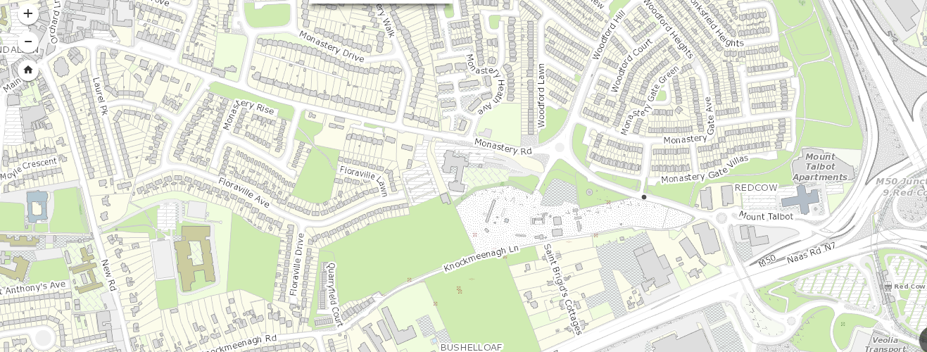
Monastery Road Walking and Cycling Scheme Extents

Slide 6
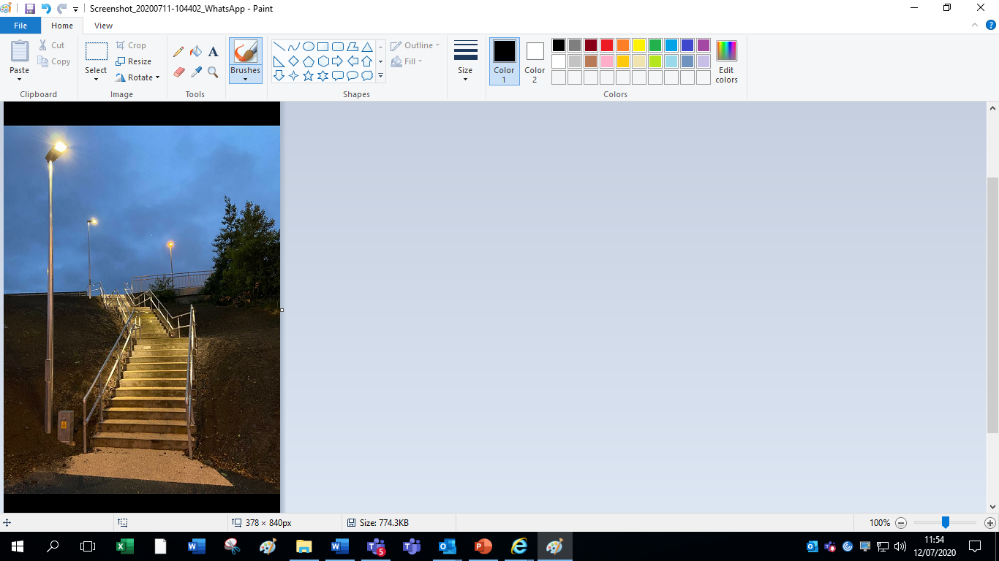
Monastery Road Scheme
Renewal and widening of paths
Reconfiguration of the SIAC roundabout
Provision of two signalised pedestrian crossings, one at SIAC roundabout on the Woodford arm and the other one on Bow bridge (L1019) south of the Ibis roundabout
Junction treatment works at Monastery Gate Entrance
Tree planting and landscaping
Provision of staircase down the eastern embankment south of Bow bridge to access the Luas stop
Undergrounding of unsightly ESB cables at SIAC roundabout
The layout of the works is being constructed in line with the drawings presented at the Clondalkin Area Committee Meeting and Public Consultation
Installation of heritage art
Improved confidence of pedestrians and cyclists to access amenities
Reduction in the speed of vehicles
Improved predictability of vehicles

Slide 7
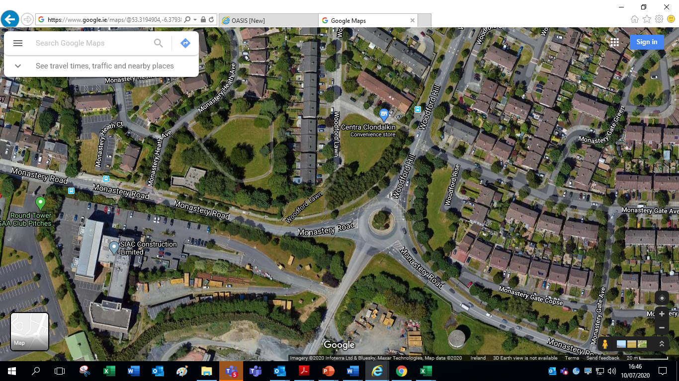
Monastery Road Woodford Hill Roundabout
Also known as the SIAC Roundabout
Substandard informal crossing facility on
Woodford Hill
Wide carriageways leading to unpredictable speeds entering and exiting the roundabout
Unfunctional roundabout; no requirement to slow down when going straight through
Unpredictability of speeds, poor sight lines, informal crossing point deters pedestrians and cyclists from using such roads

Slide 8
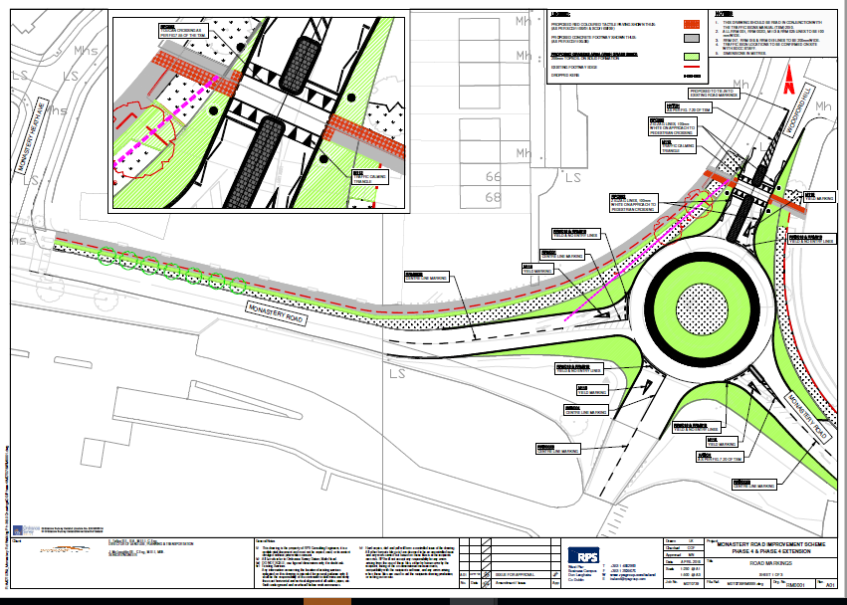
Proposed New Roundabout
Aerial pic of FULL scheme
Raised Signalised Crossing
One lane entry and exit
Larger central island with overrun area
Predictable speeds
Confidence in safety for vulnerable road users

Slide 9

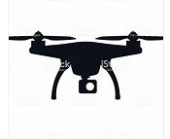
Traffic Counts and Drone Surveys
Wednesday 15th May 2019
Junction Turning Counts from 07.00 to 19.00
Queue Length Observations from 07.00 to 19.00
Pedestrian Counts
Bus Stop Surveys
Bus Journey Time Surveys
Automatic Traffic Counts 00.00 to 24.00
Thursday 14th November 2019
Drone footage was taken from 07.45 to 09.20
New roundabout layout marked on road
SIAC vehicles; large heavy goods vehicles, used to traverse existing roundabout with new markings

Slide 10
Traffic Queuing and Bus Counts 15.05.2019
Traffic Counts on Woodford Hill
Bus 13 travelling from bus stop on Woodford Hill to SIAC Roundabout to IBIS Roundabout to Bus Stop on Monastery Road
**These journey times are acceptable
15.05.2019 Time | Vehicles turning Right towards Village | Vehicles turning Left towards IBIS R’bout
07.30 | 4 | 19
07.45 | 2 | 18
08.00 | 4 | 9
08.15 | 3 | 16
16.45 | 4 | 28
15.05.2019 Bus 13 Time | Total Duration - Bus Stop to Bus Stop**
07.37 | 2 min 27 secs | Journey Duration Breakdown Bus 13 at 08.13am on 15.05.2019 * Includes time taken for passengers to enter and alight
07.48 | 3 min 01 secs | Bus Stop Woodford Hill – SIAC Roundabout | SIAC Roundabout to IBIS Roundabout | IBIS Roundabout to Bus Stop
07.55 | 2 min 43 Secs | 2 min 52 secs* | 1 min 50 secs | 0 min 20 Secs
08.13 | 4 mins 50 secs

Slide 11

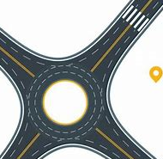
Addressing Technical Concerns of Citizens
New roundabout design is in harmony with the road structure leading to junction 9 on the M50 motorway
Modelling shows queuing times of vehicles will marginally increase on Woodford Hill
Emergency Services have sufficient space to traverse roundabout
Larger central island with overrun area for buses and HGV’s
Analysis showed there would be no significant impact on traffic flows or capacity

Slide 12

Statutory Process
Date | Item | Comment
16.05.2018 | S38 Phase 4 Presented to Clondalkin Area Committee Meeting (CACM) | Noted by Councillors
24.05.2018 | Notice published in The Echo newspaper
24.05.2018 – 27.06.2018 | Public Consultation | Information available; County Hall, Tallaght Civic Offices, Clondalkin www.sdcc.ie SDCC Public Consultation Portal
19.09.2018 | S38 Report for Phase 4 Presented to CACM | Noted by Councillors
17.04.2019 | Monastery Road Walking and Cycling Scheme Update Presented to CACM | Noted by Councillors

Slide 13
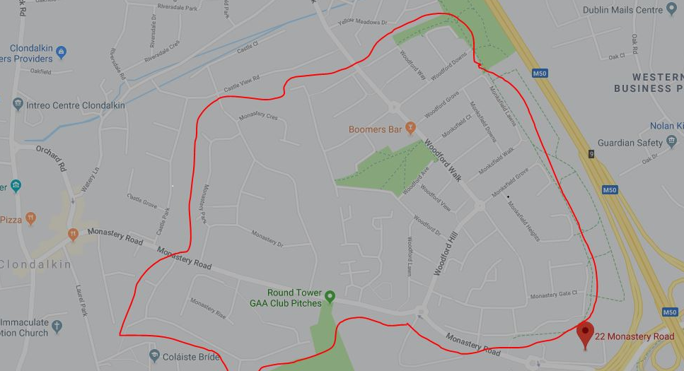
Leaflet Drops and Vehicle Messaging Signs
Vehicle Messaging Signs notifying of roadworks placed on Monastery Road and Woodford Hill
Leaflet Drops notifying of roadworks were carried out by SDCC in October 2019
Leaflet Drops notifying of roadworks were carried out by DM Morris, Contractor of Works, in February and June 2020
Tidy Towns Committee notified
An Garda Síochána notified

Slide 14

Amendments under Review
Zebra crossings at the IBIS roundabout
Yellow boxes on the SIAC roundabout
Traffic lights on SIAC roundabout
Two lane entry on Woodford Hill

