Slide 1
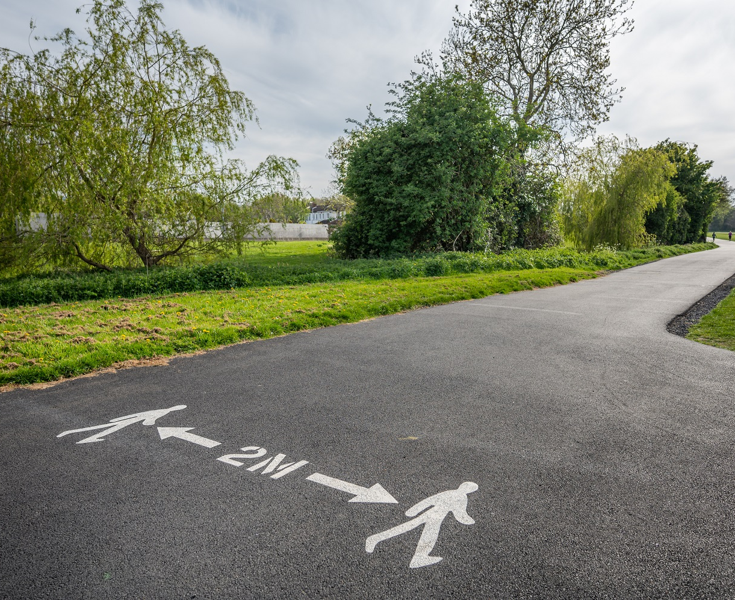
Annual Staff Briefing 2021

Slide 2


Annual Staff talks
Communications commitment.
Opportunity to say thanks!
Review the year gone by
Look forward
Remind ourselves of why we do what we do
Corporate ambition and commitment !

Slide 3


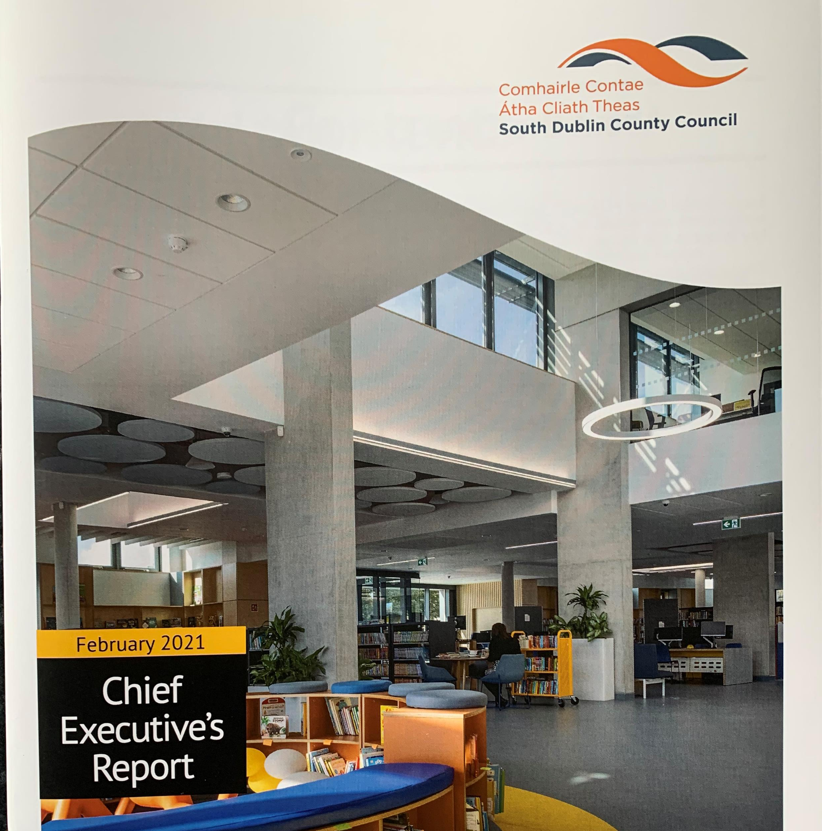
Communication internal and external.
Annual and biannual publications
Monthly chief executives report
Staff surveys – new starters and remote working.
Digital newsletters – top 5 items.
Intranet
Digital screens depots and canteen
Social media continues to grow

Slide 4
Social media – engagement growth
2020
705,441
2019
520,023
2018
2017

Slide 5
IMPRESSIONS GROWTH
2020
17,991,814
2019
11,640,670
2018
2017

Slide 6
Staff survey – new starters 2015 – 2019.
416 invited to participate – 165 responded ( 39% )
92% found overall experience positive or very positive
Very complimentary towards other staff and welcome received.
80% happy with induction ( 90% outdoor 76% indoor )
7% not happy with opportunities to give feedback.
Strong appetite for continued communication on what's going on in other departments
Some disappointment with interview feedback and training opportunities
13 follow up recommendations.

Slide 7
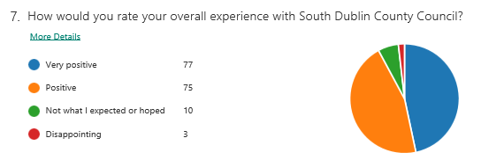
Staff survey – new starters 2015 – 2019

Slide 8
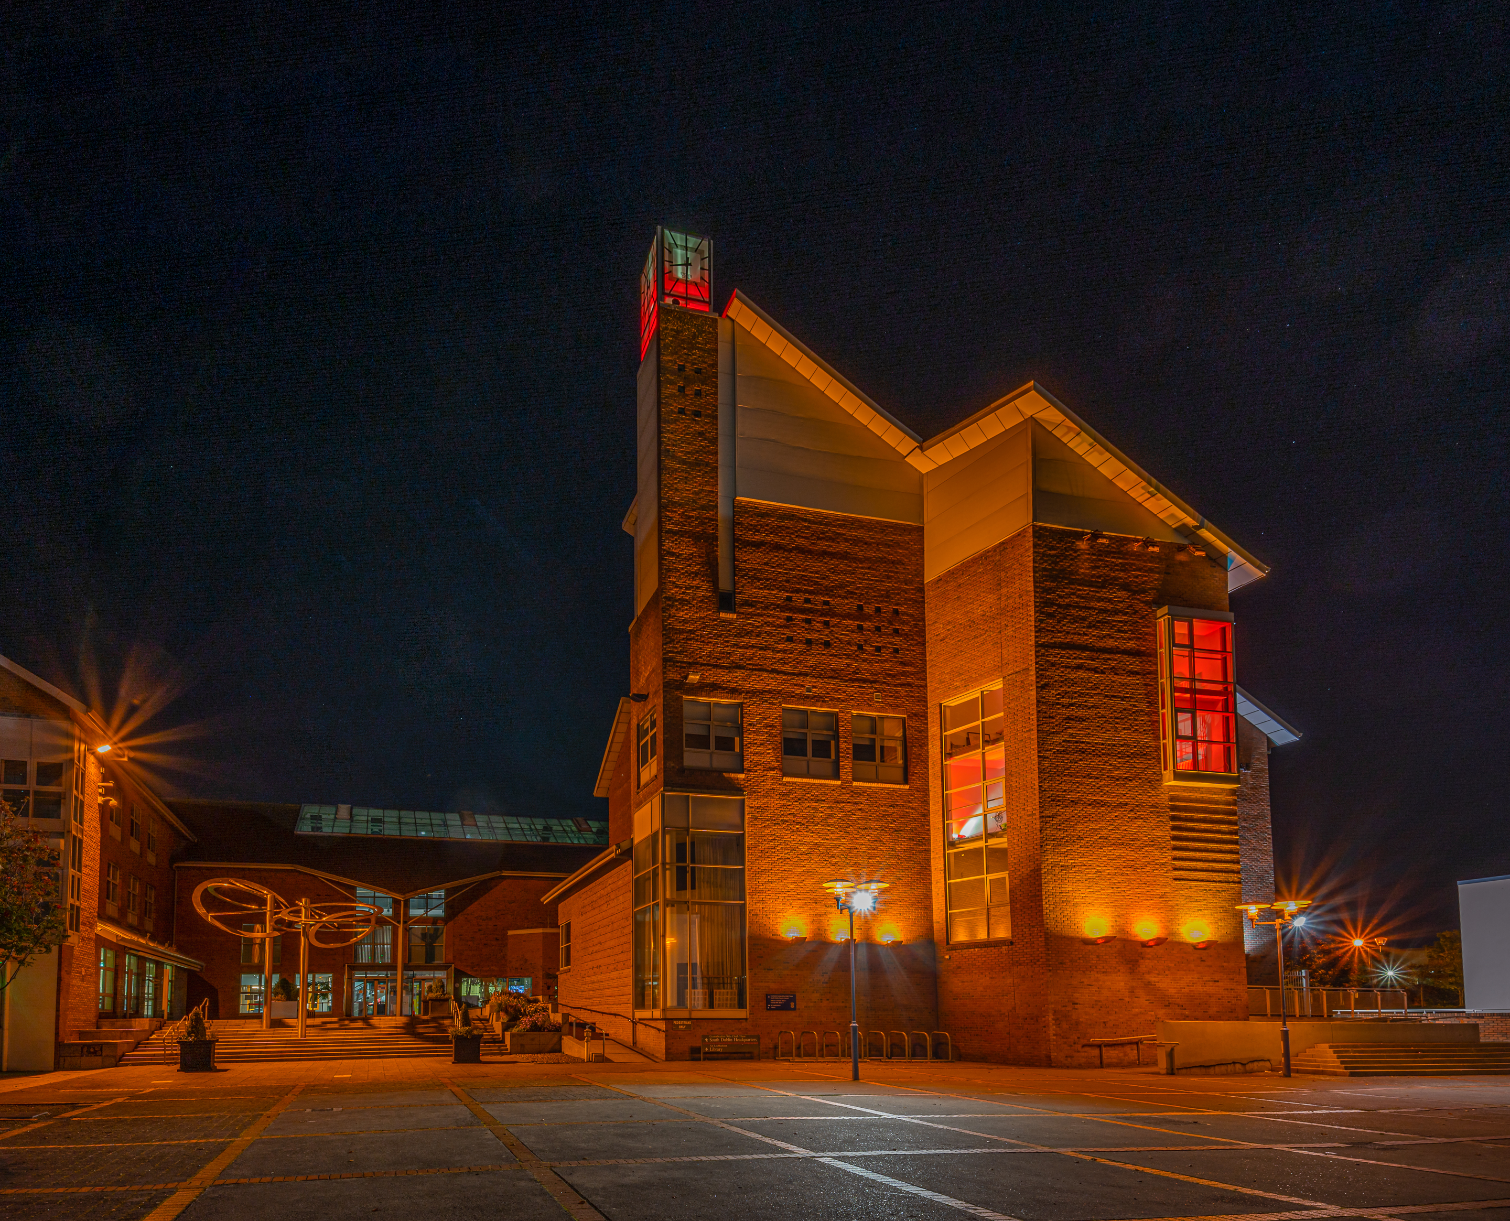

Remote Work Survey

Slide 9
Who took the survey?
570
Complete Responses

Slide 10
5%
What age are you?
Aged 18-29
23%
Aged 30-39
35%
Aged 40-49
27%
Aged 50-59
10%
Aged 60+

Slide 11
34%
How often are you working remotely?
Full time
26%
3-4 days per week
11%
1-2 days per week
29%
Full time but dropping
in when needed

Slide 12
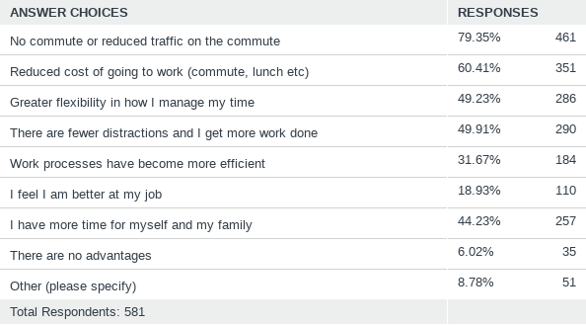
What are the main advantages to remote working?

Slide 13
Agree or disagree?
I receive regular contact from my manager while working remotely.
82%
Agreed or strongly agreed
10%
Disagreed or strongly disagreed

Slide 14
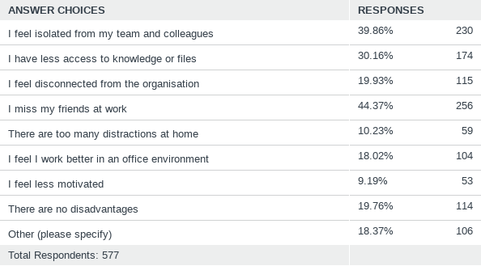
What are the main disadvantages to remote working?

Slide 15
Would you avail of a 20% remote working opportunity, if available?
86%
Yes
6%
No

Slide 16
Agree or disagree?
I feel I am as effective working remotely as I would be anyway.
73%
Agreed or strongly agreed
15%
Disagreed or strongly disagreed

Slide 17
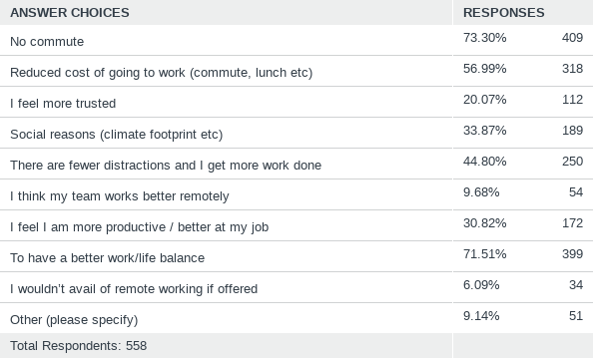
What would be the main reasons you would like to remote work?

Slide 18
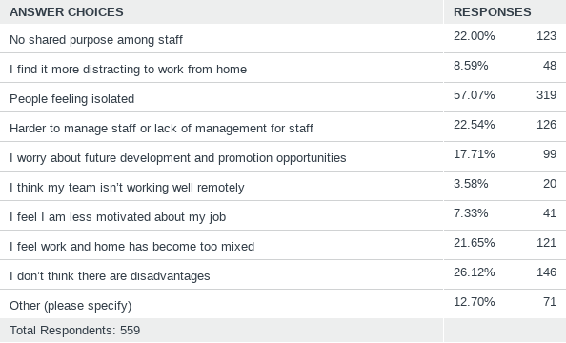
What are the main disadvantages to remote working going forward?

Slide 19
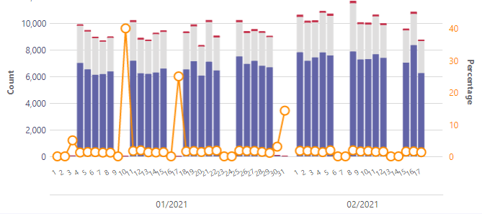
Average 10,000 Video streams daily – 214,442 February.

Slide 20
SAMPLE Date range: 90 Days Nov 18, 2020 - Feb 15, 2021
180,082 Chat Messages
86,978 1:1 Calls Made
1,998,188 audio time (minutes)
651,001 Video time (minutes)
476,488 Screen share time (minutes)
7,194 Total Meetings Organised
55,239 Total Meetings participated

Slide 21


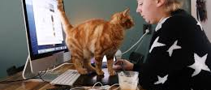
-- Current challenges – forced !
-- expectations – 20% ?
-- staff survey – 650 participated.
-- societal considerations
-- where it might go
- policy – working time act ?
- blended working policy
- tech. innovation – workflow
- driven by norms – working day/ week - public demand
-- biggest challenge – equity.
Remote working

Slide 22
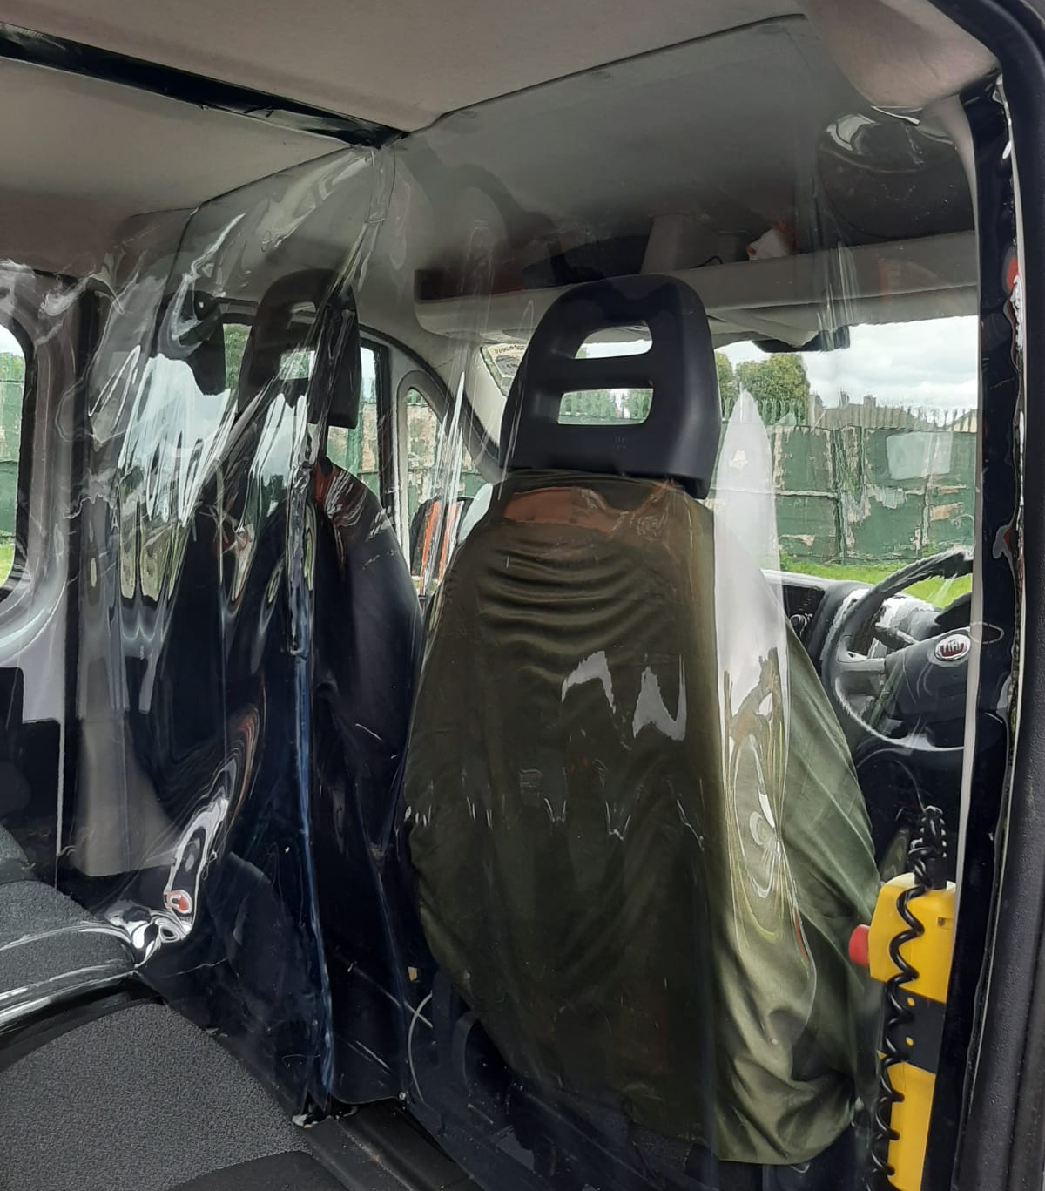
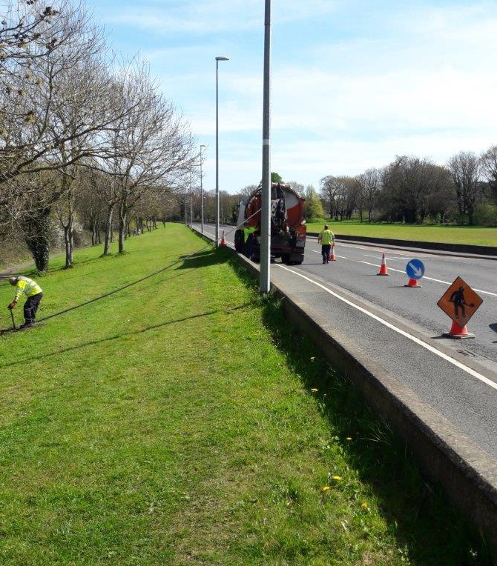
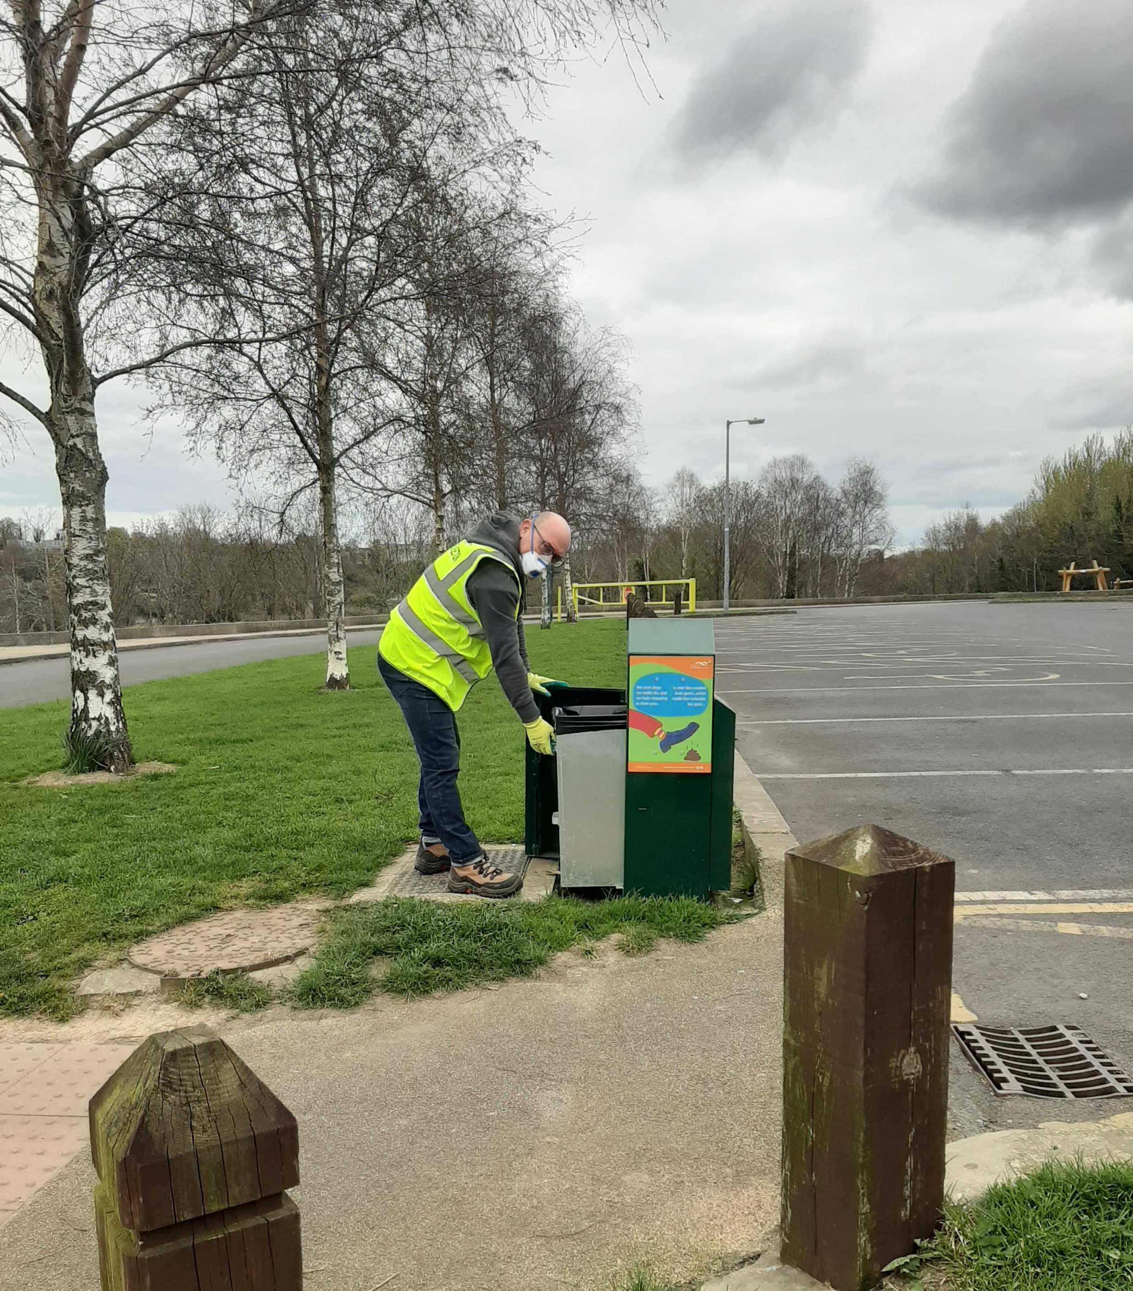
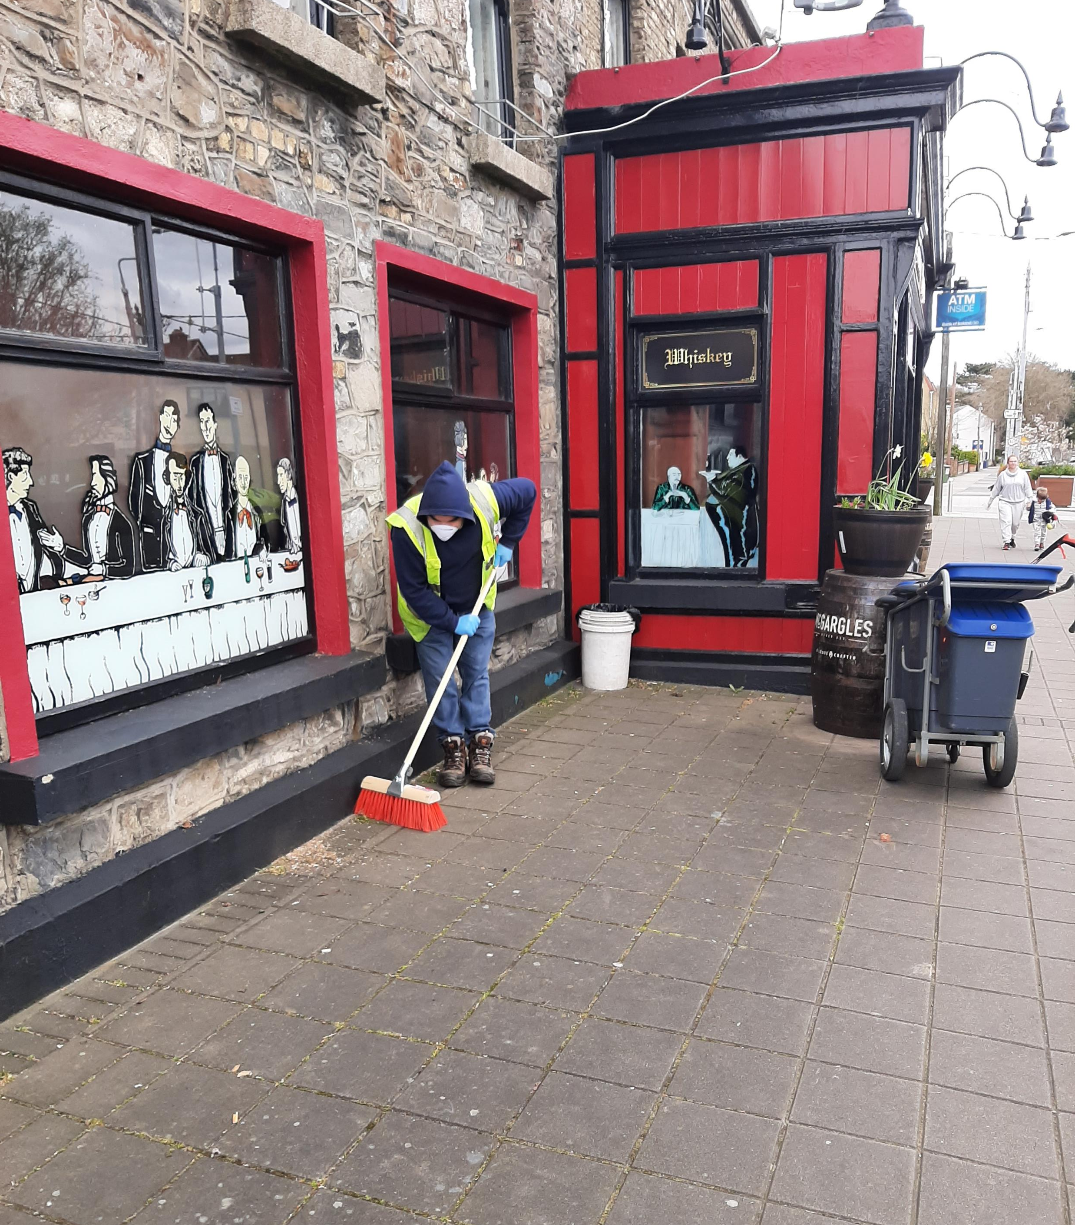
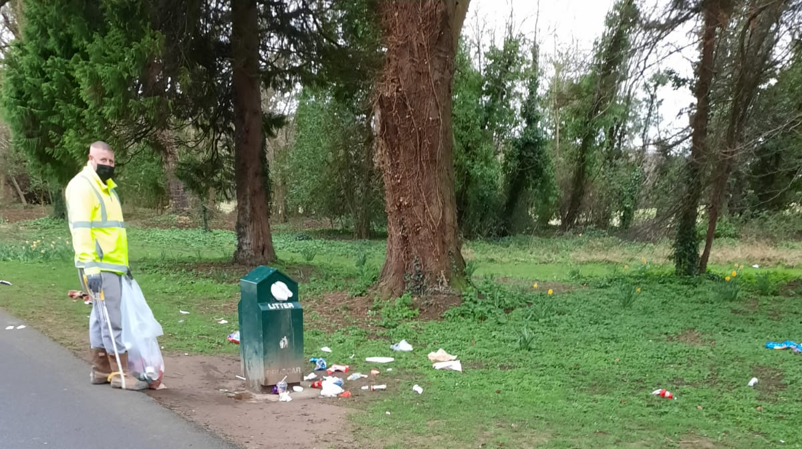
Post Covid considerations
What are the considerations
Continuation of covid protective gear
Depot layouts
Staggered start times
Greater flexibility in work arrangements.
It will require careful consideration – fairness , productivity etc

Slide 23

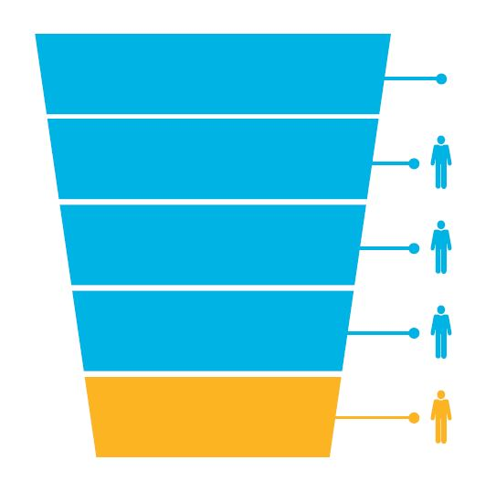
Organisational Capacity - Staffing
 | ‘15-’18 Total | ‘19 | ‘20
 | ‘15-’18 Total | ‘19 | ‘20
Head Count (as % of WFP)
4838
91%
1261
92%
1258
91%
New Employees
518
121
63
Applications Received
9185
1533
3477*
Promoted
435
71
48
Interviewed
4293
844
243
Mobility
204
26
39
Competitions Advertised
268
44
34
Leavers
432
133
73
Interview Boards
223
54
16
Turnover %
8.9
10.5
5.8

Slide 24
Progress: December 2020 – Feb 2021
The previous 3 month’s figures are only slightly short of figures for the entire of 2020
54 days spent interviewing ( total of 58 available).
34 vacancies were filled in this 3-month period.
1st Dec 20: There were 28 indoor posts to be advertised. By end Feb all will have been advertised and are at - review / shortlisting / interview / apt stage. (Plus, additional posts not vacant at 1st Dec).
1st Dec 20: There were 5 outdoor posts to be advertised. By end Feb 2 remain to be advertised together with 3 additional post.
Not including 1808 EOI
 | 2020 | Dec 20 - Feb 21
Applications Received | 1669* | 1630
Number Interviewed | 243 | 238
Competitions Advertised | 34 | 26

Slide 25
Total Reported Incidents & Average Absence 2011 - 2020
 | 2020 | 2019 | 2018 | 2017 | 2016 | 2015 | 2014 | 2013 | 2012 | 2011
Total Reported Incidents | 39 | 71 | 73 | 70 | 69 | 58 | 73 | 76 | 75 | 50
> 3 Days IR1 | 13 | 17 | 8 | 11 | 11 | 13 | 15 | 19 | 17 | 22
< 3Days | 1 | 4 | 1 | 5 | 9 | 1 | 1 | 0 | 0 | 0
Total work days lost | 244 | 192 | 174 | 326 | 256 | 692 | 644 | 465 | 340 | 880
Average days / Incident | 19 | 10 | 19 | 20 | 15 | 49 | 56 | 37 | 20 | 38

Slide 26
Incident Triggers resulting in absence from work 2016 - 2020
 | 2020 | 2019 | 2018 | 2017 | 2016
Slips / Trips / Falls | 6 | 6 | 2 | 1 | 9
Pushing / Lifting / Bending | 4 | 6 | 2 | 2 | 2
Incidents Involving Vehicles or Contact with Equipment | 3 | 5 | 5 | 6 | 5

Slide 27

Safety management system 2020
Senior management Objectives - 7/7 objectives completed
Annual Work Programme 22/25 objectives completed
  Lone working app – pilot completed 2019
  H&S Seminar
  SMT Inspections
HSA Inspections / Communications 4 X Workplace Contact Unit,
15 H&S Inspections
173 COVID 19 Inspections

Slide 28
Training events 2020
Health and safety courses – 151 involving 1198 participants
Excluding COVID induction – 113 with 783 participants
Other general training – 182 courses with 560 participants
Budget available for staff assistance - €100,000
Budget spend €98,442.

Slide 29

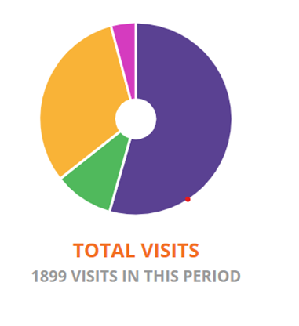
Staff Wellness Portal
246 Registered users
1899 visits – vast majority on wellbeing tips
6577 pages viewed
14 wellbeing webinars
  Remote working
  How to be happy
  Building resilience
average 160 attendees
Next up 24th march and 21st April – look them up.

Slide 30
COVID-19
Sincere appreciation for effort and cooperation in the name of essential public services , community and business support.
Significant flexibility and innovation in terms of patterns of working , public consultation and service delivery
Front line services and maintenance regimes maintained.
ICT support programme – Critical to success
Very significant health and safety effort
Business supports – rates waiver , restart grant , business continuity and trading online vouchers
Community call
Online community support and wellness programmes

Slide 31
COVID-19 positives
A sense of achievement
Positive and appreciative public reaction – community call – front line services – online supports etc.
Innovation we will hold onto – digital and practical.
Work practice that offer lessons
22% drop in sick leave
Uptake and appreciation of our wellness programme
Health and safety COVID response programme.

Slide 32
COVID – what next ?
Dependant on vaccine delivery , cost to economy and public tolerance of restrictions.
Unlikely to see much change until early summer with incremental improvement thereafter.
Organisationally we can expect some level of restrictions for the remainder of the year.
The public health , personal health and economic challenges continue to be significant but will recede with vaccine rollout.
2021 likely to be a challenging year for SDCC but manageable and no plans to decelerate any plans or recruitment – overall well positioned to deal with financial disruption.

Slide 33
COVID – What next ?
By year end and into next year we should see greater confidence in our ability to manage residual impacts
One assumes there may need to be annual vaccination programme
National economy will be significantly impacted
  €40b additional debt at least – must be repaid – albeit at low rates
  Significant additional public expenditure ( particularly in health) that will not be withdrawn and government will need to find new money to pay for – we are part of government.
  Small business in most impacted areas ( hospitality , tourism , personal services , travel , leisure – may well result in some closures – expect supports?
  Expect significant government expenditure on housing and other construction projects to boost employment and taxation – we will benefit !
  We need the public to start spending again in a big way to boost vat receipts - €124b in personal savings so plenty of scope.
  Prospects for strong economic recovery – positive.

Slide 34
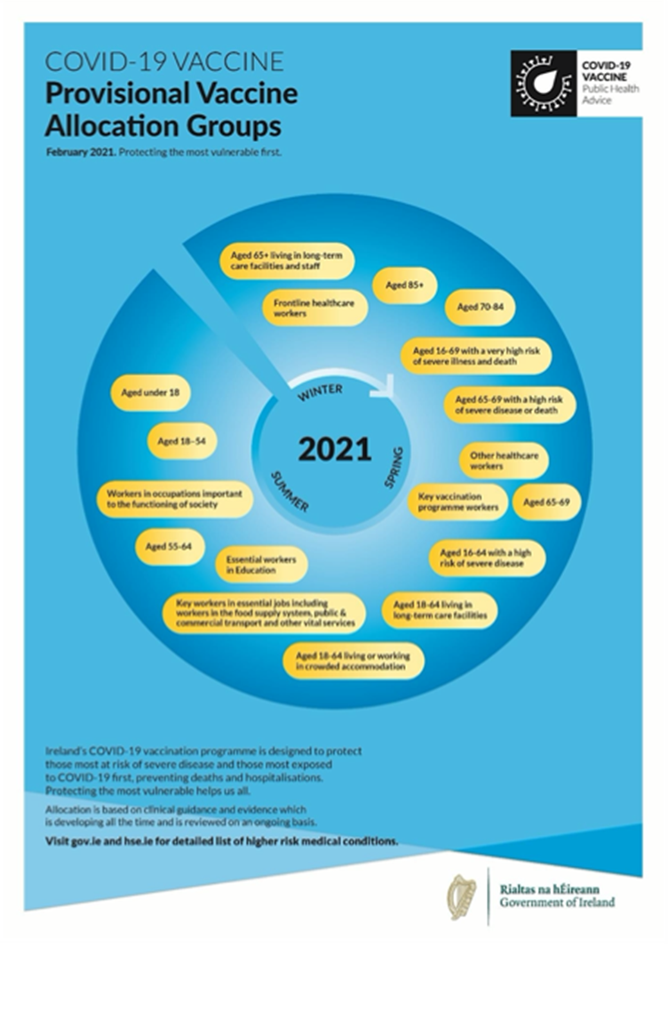
Covid Vaccination groups
Order of priority set
Only change has been medically very vulnerable
Considerable pressure from respective groups / unions including teachers /gardai etc.
CCMA has sought to get some understanding of a more favorable view around front line essential services – to move some workers that cannot avoid high risk of exposure into stream 10 – key workers
Discussed with department – No response to date.

Slide 35
Budget 2021 – Spend.

Slide 36
Budget 2021 – payroll

Slide 37
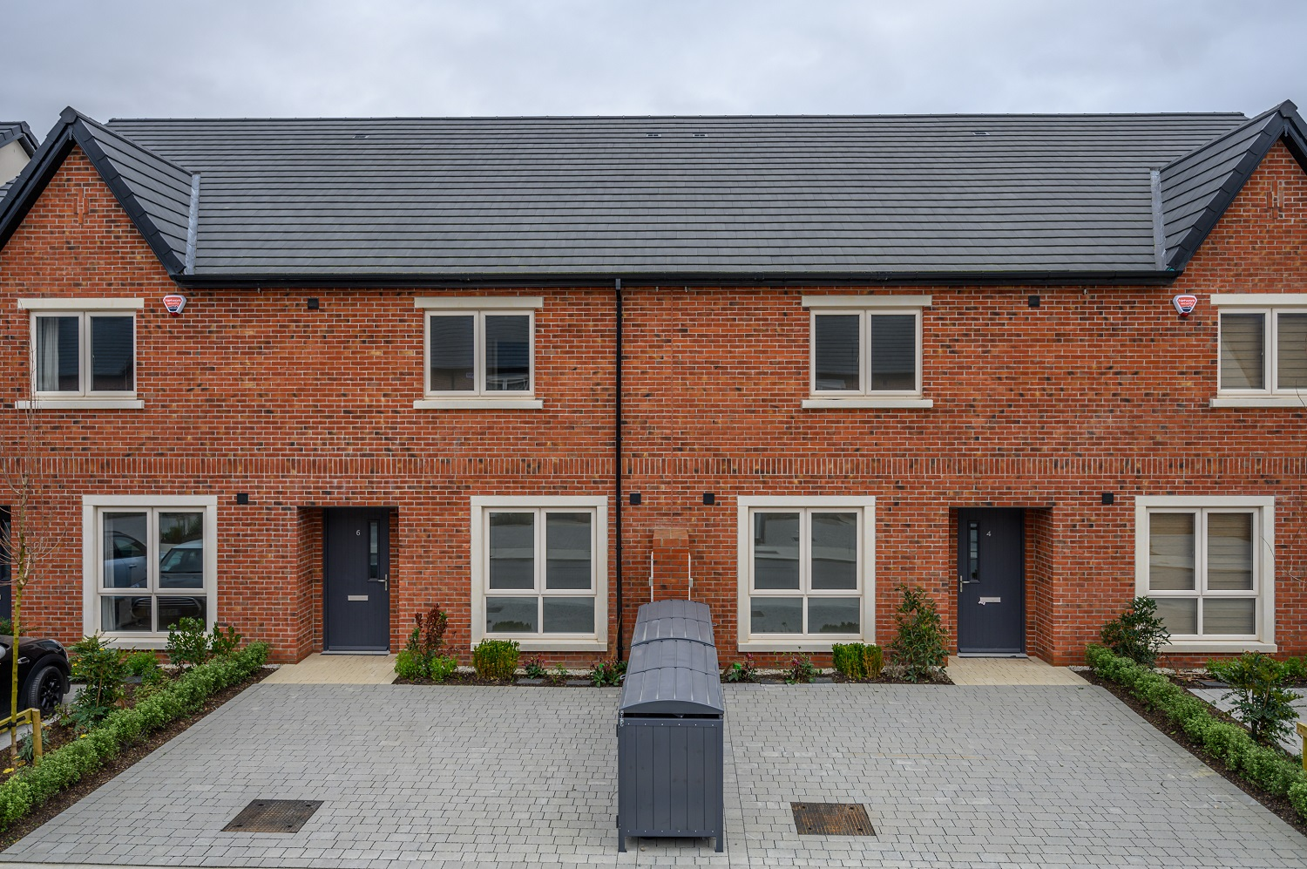
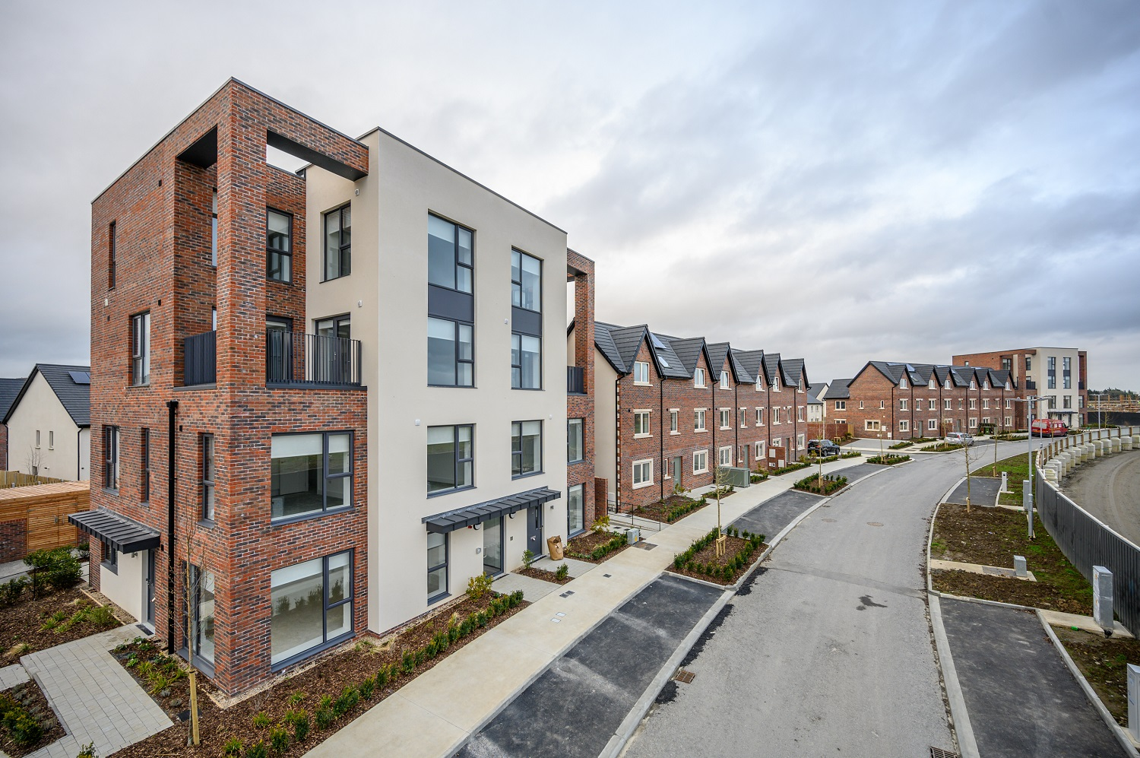
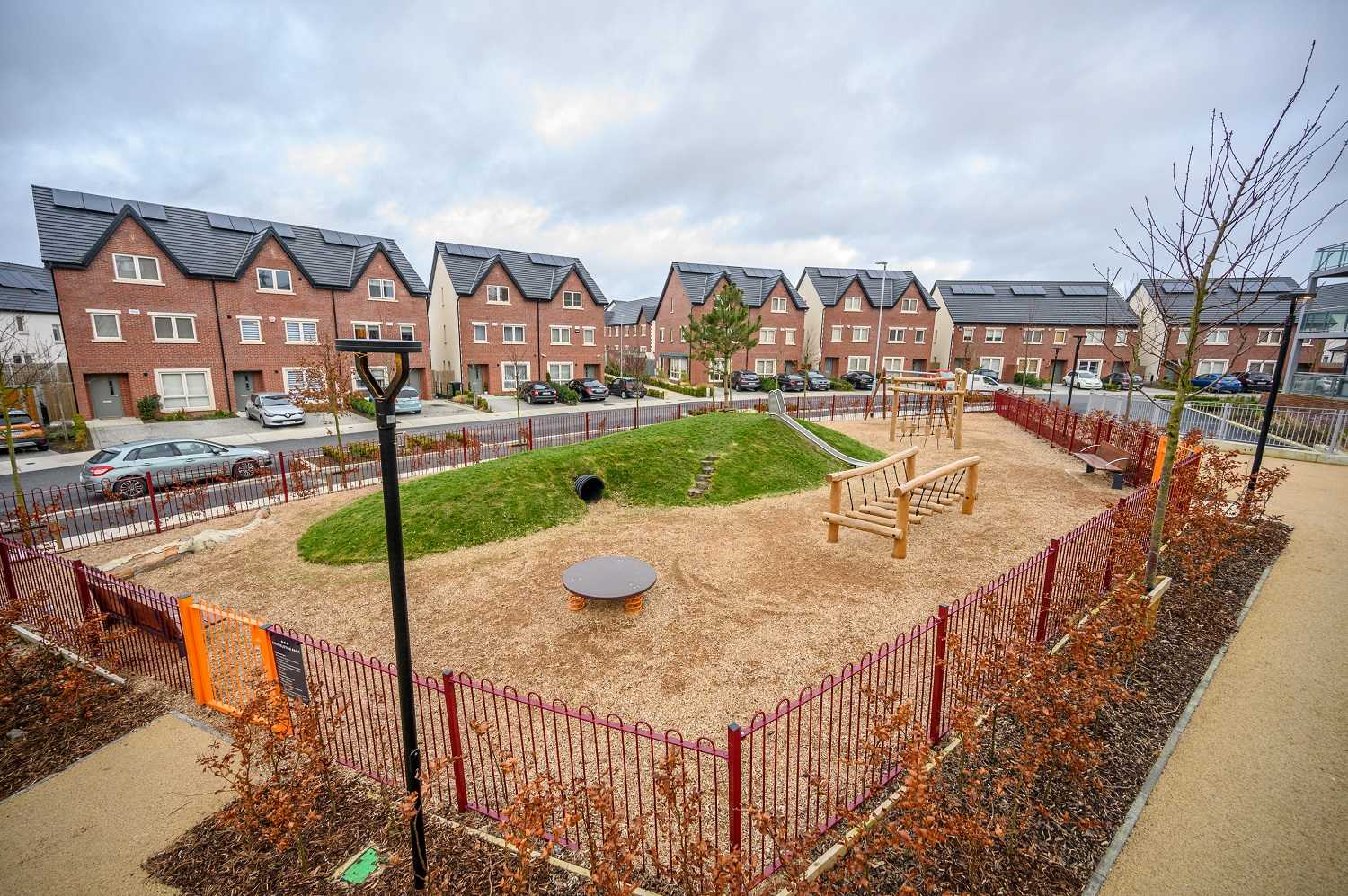
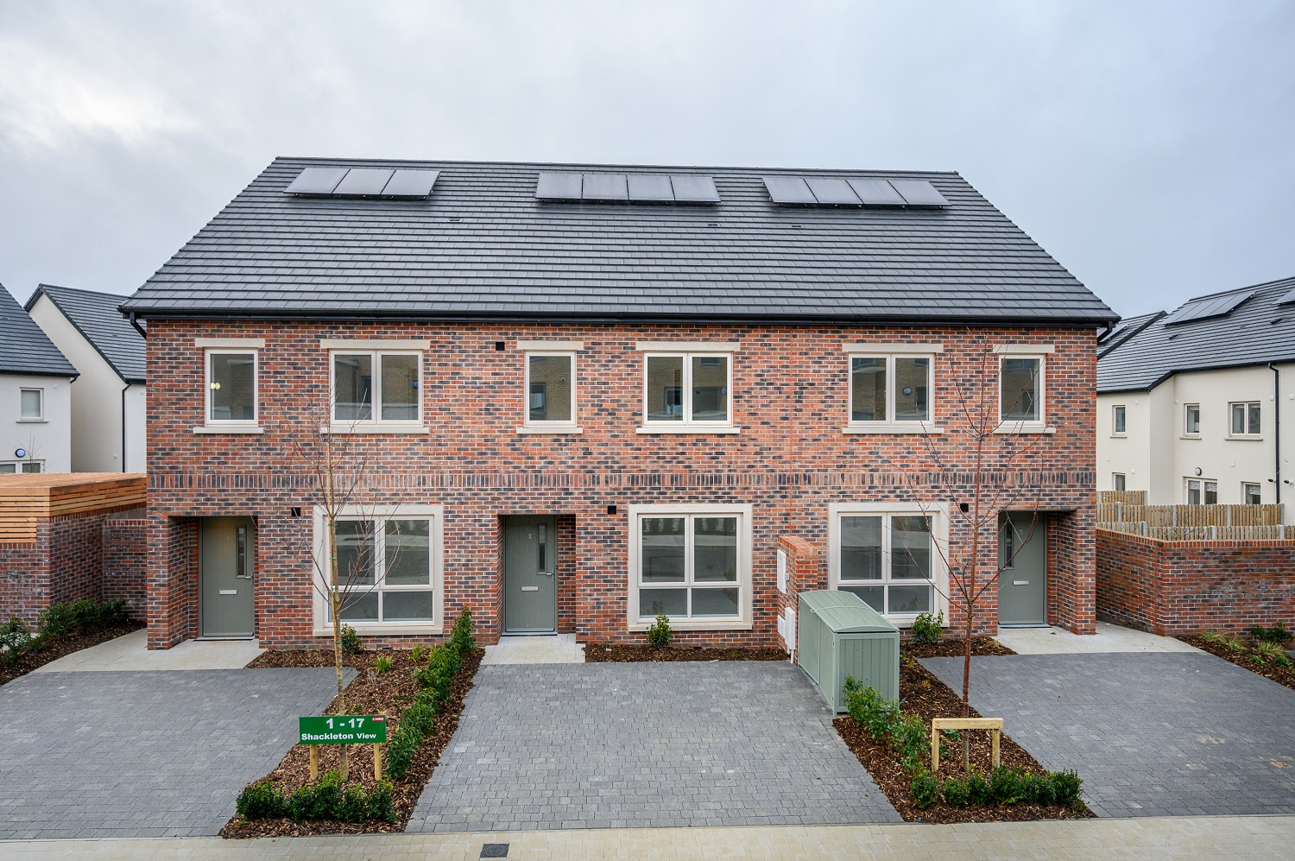
Housing delivery 2020
New homes delivery 536
Incl. part 5 – 103
HAP – 463 new tenancies.
Allocations& offers –over 700
37% to homeless families
Homeless families in self accommodation down from high of 223 to circa. 50

Slide 38
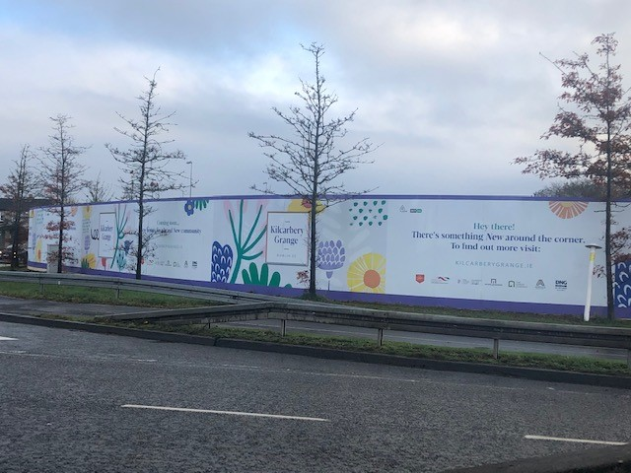
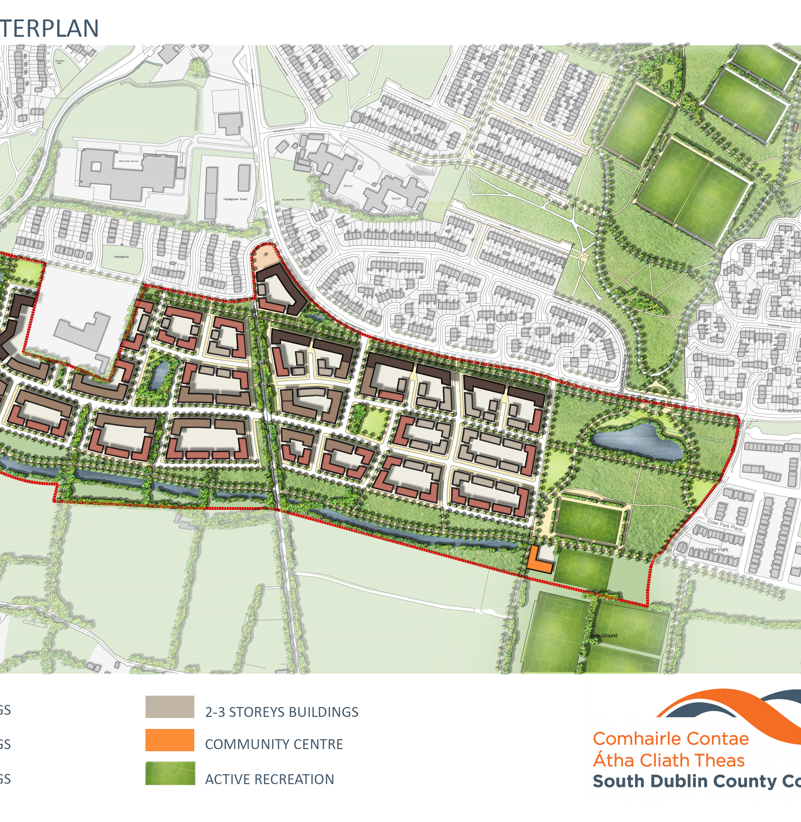
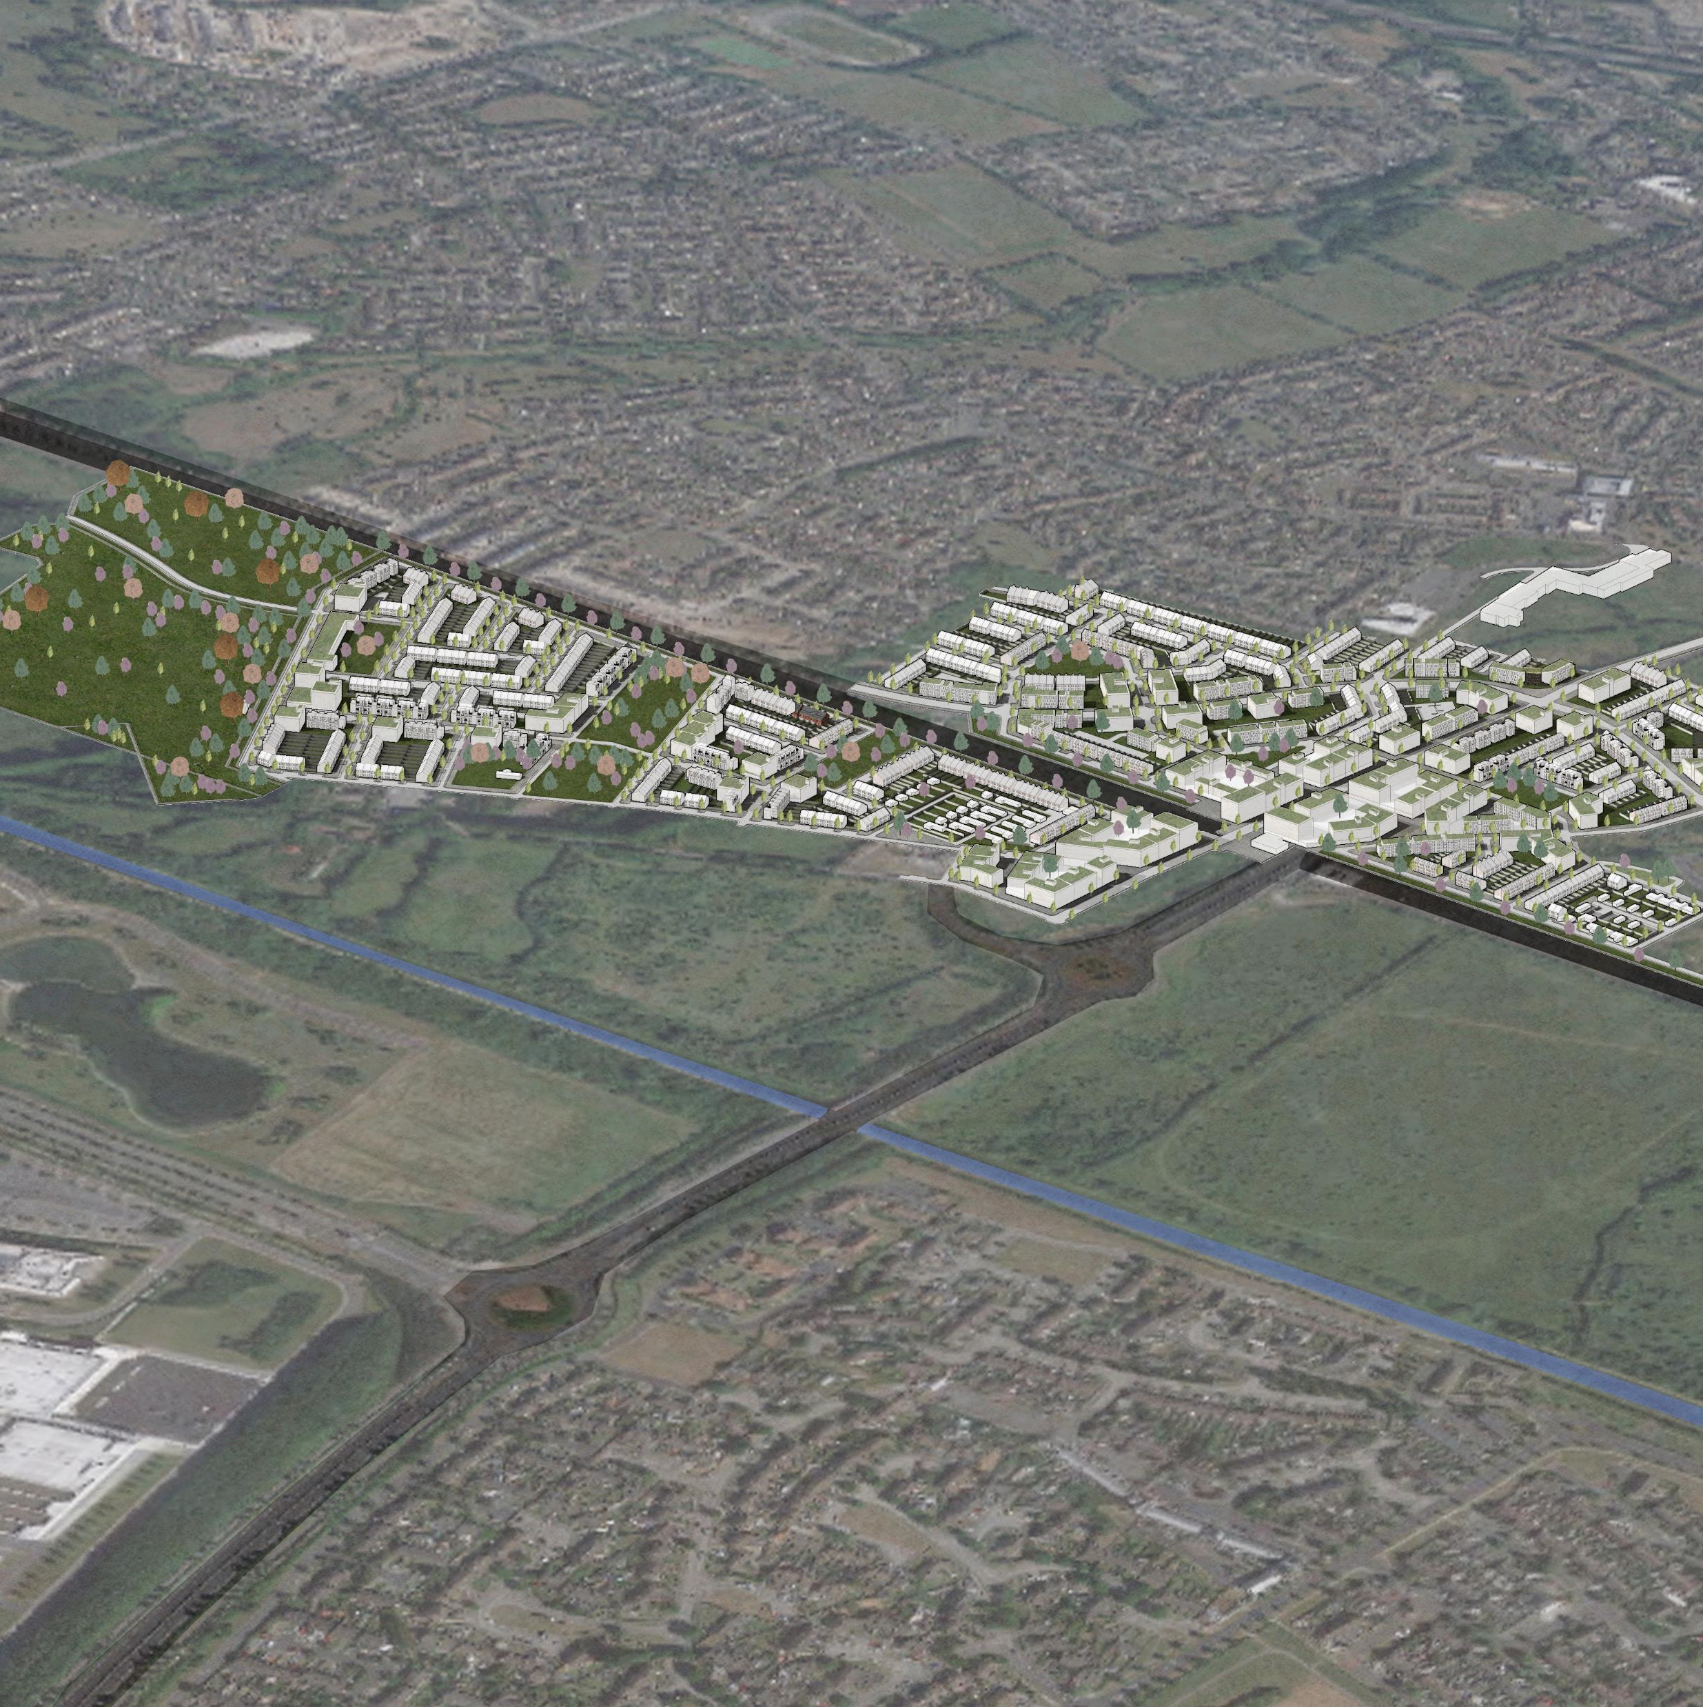
Major Housing sites
Kilcarbery ( 1030) to commence
Killinardin ( 500) – 2 tenders
Clonburris ( 2500) – infrastructure proposal funded – phase 1 ( 270) to planning this year.
Rathcoole - ecological studies.
Cost rental – belgard north 133 apartments

Slide 39

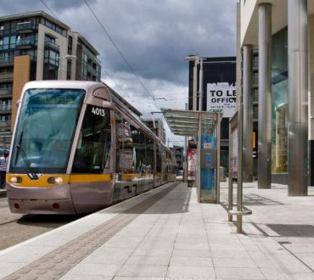
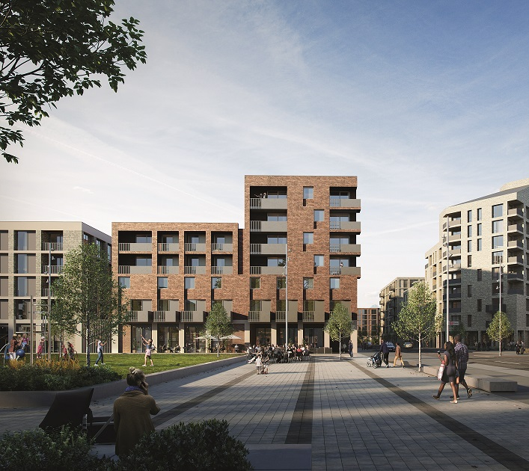
URDF funding
Tallaght - €32m
Clonburris €176.5m
Adamstown €9.7m

Slide 40
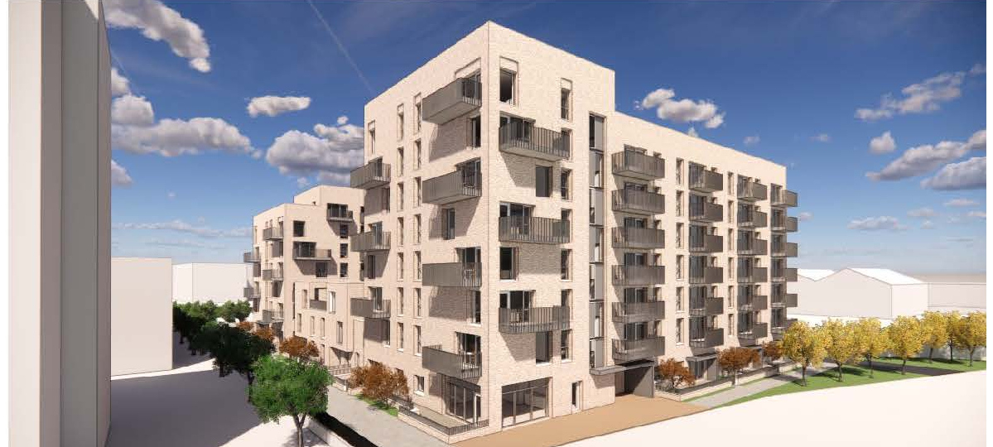
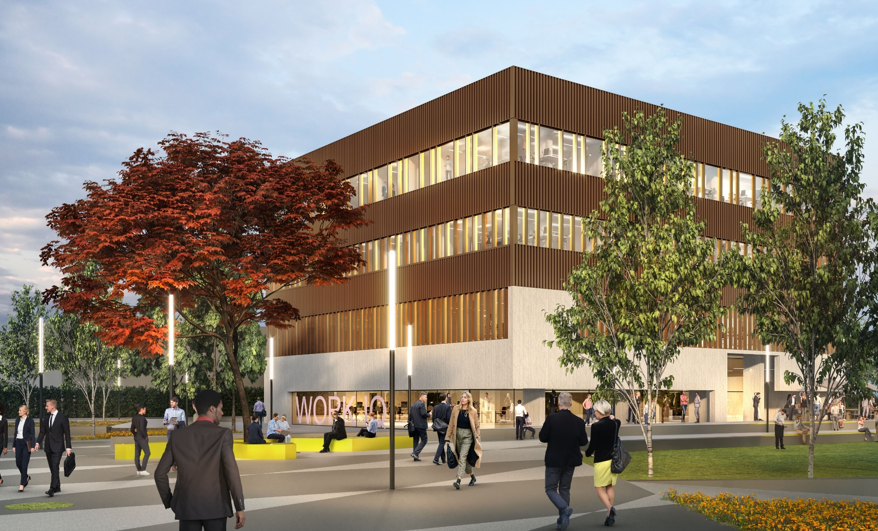
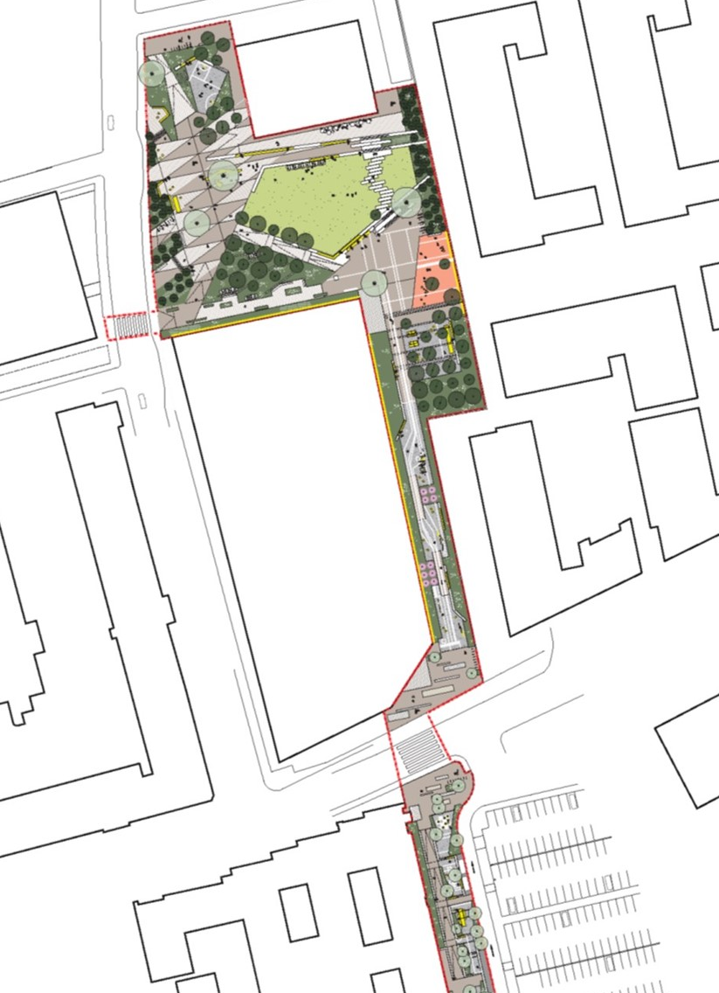
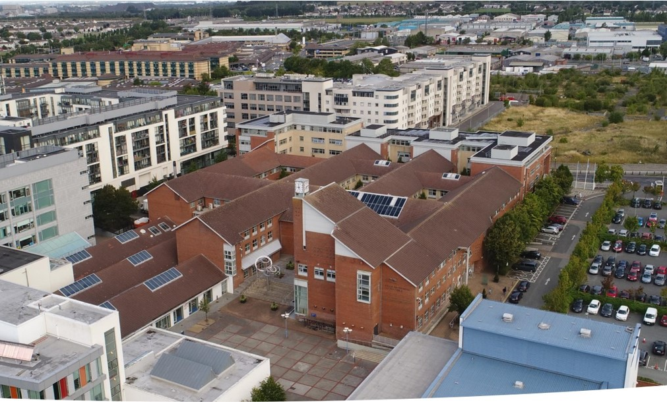
Tallaght public realm - URDF
Total investment Tallaght URDF projects €45M -- €32M government support in URDF funds
Plus €36m apartment scheme
Link Roads
New innovation square
Revamped chamber square
Innovation Centre
New pedestrian walkway
Affordable apartments – 133.
Post Primary School site.

Slide 41
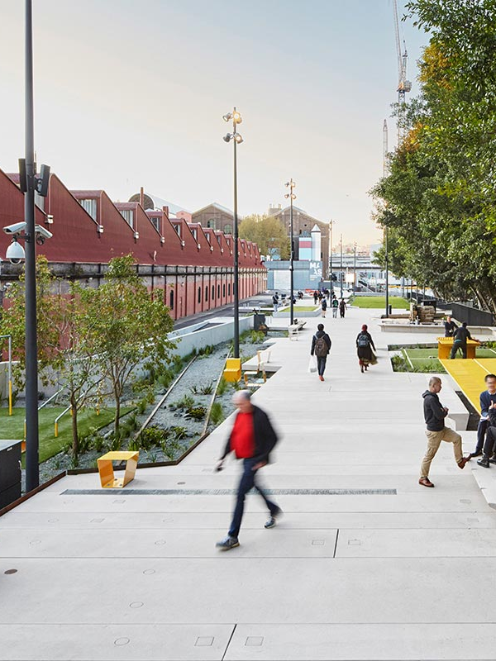
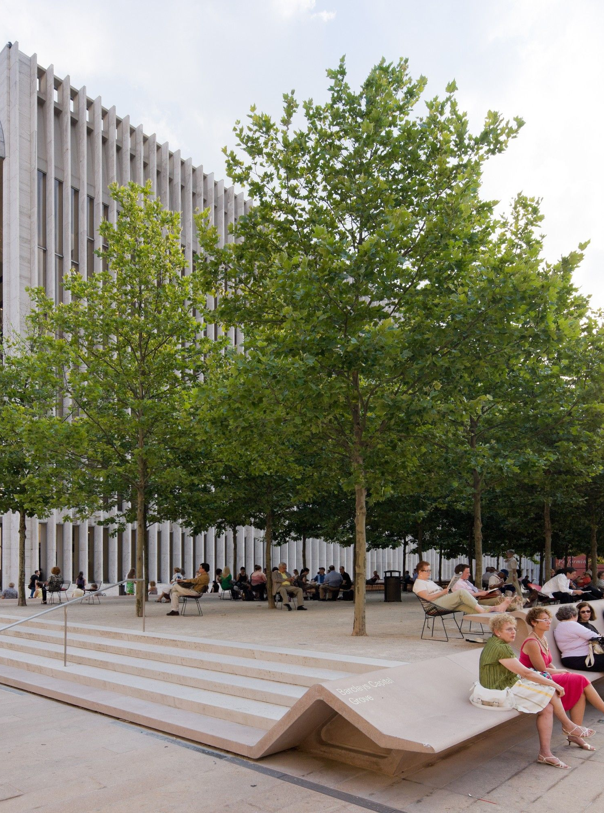

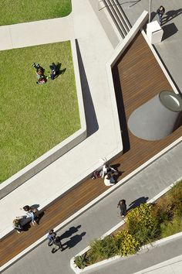
Tallaght Innovation Square
New civic plaza – centrepiece for expansion of town centre – branded as part of Tallaght innovation Quarter

Slide 42



Tallaght Innovation Quarter – Branding
Innovation elements
  Innovation square
  District heating scheme
  Affordable housing
  Innovation Centre
  Education and innovation

Slide 43
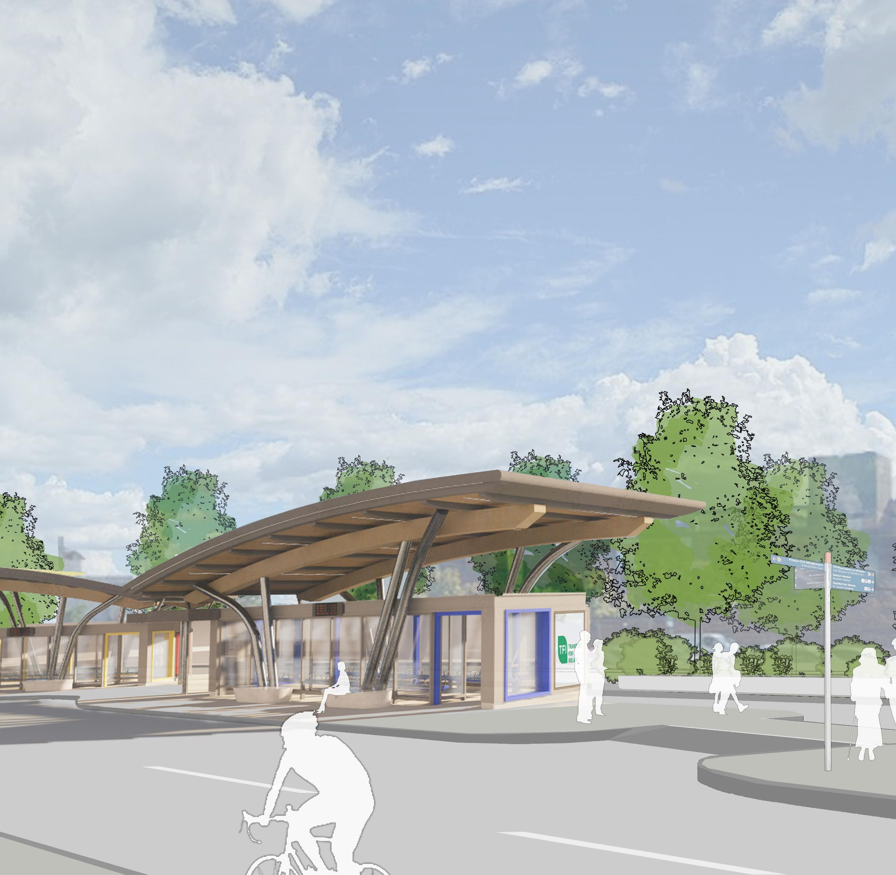
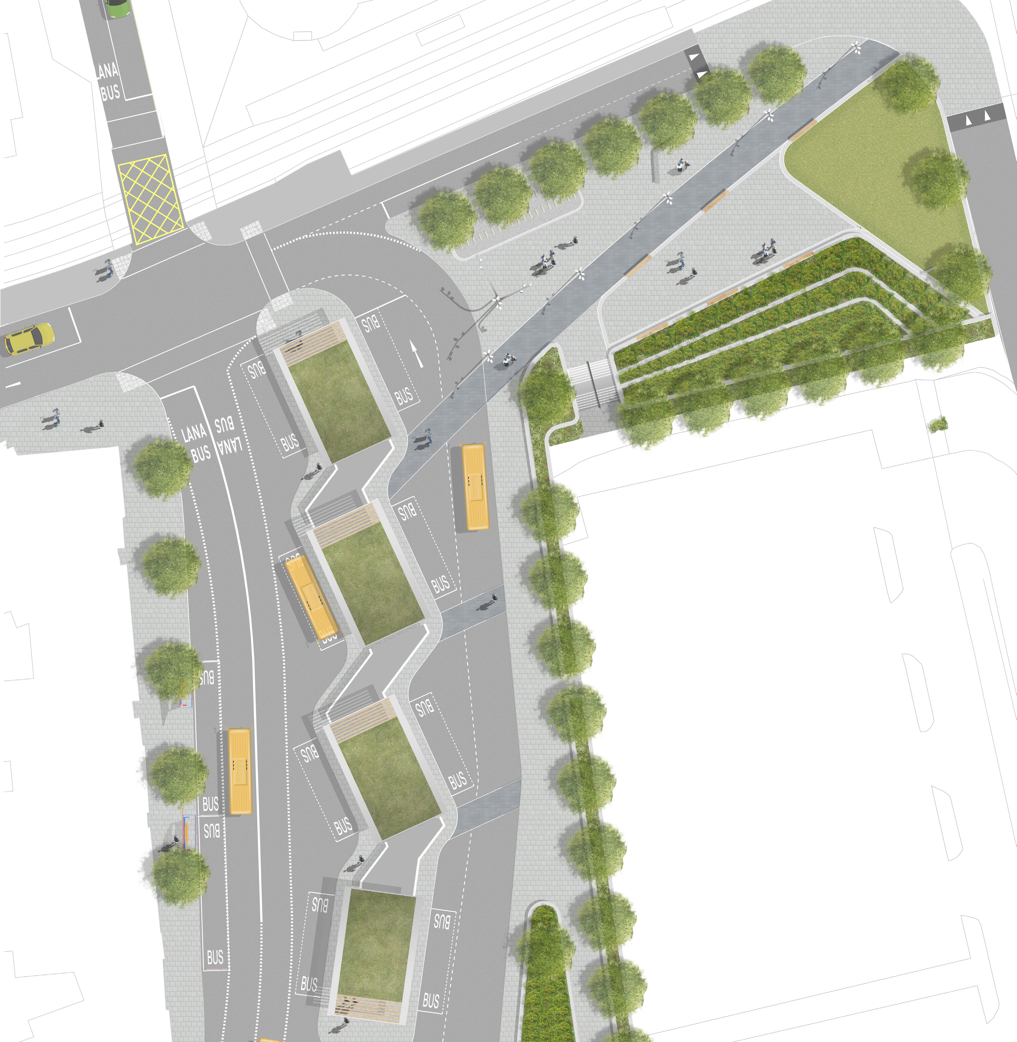
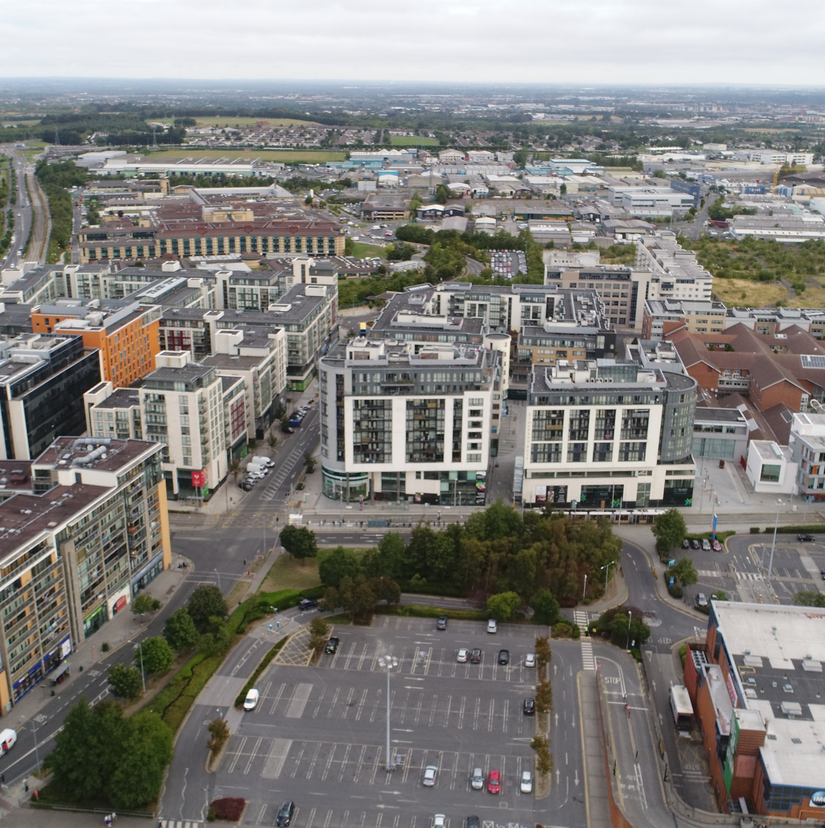
Mobility Hub
At the Luas Terminus – connection point for bus, taxi, E cars, E bikes
Public information point
Public plaza

Slide 44
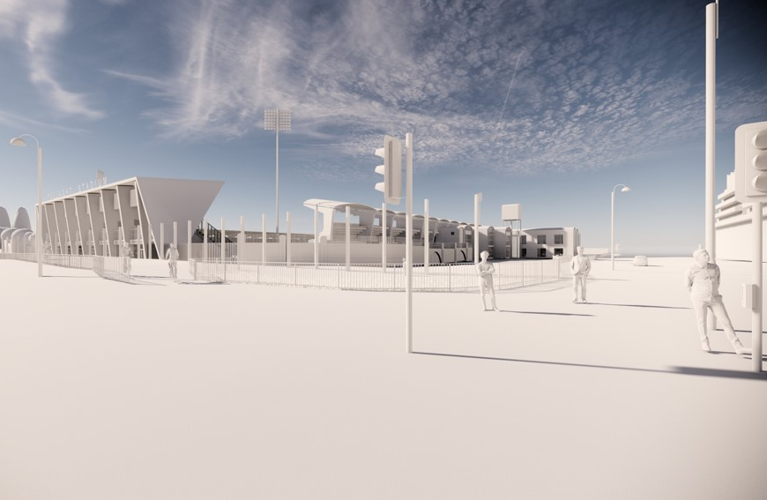
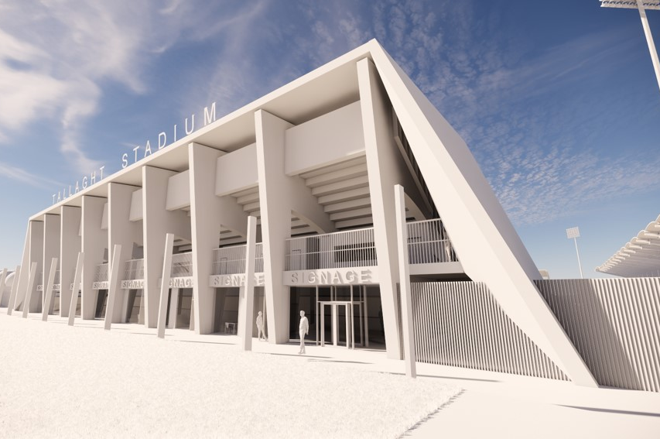
Tallaght stadium
€7m investment – new north stand – new corporate area – relocation of SR offices and store – new press area – EUFA category 4 – on site later this year.

Slide 45
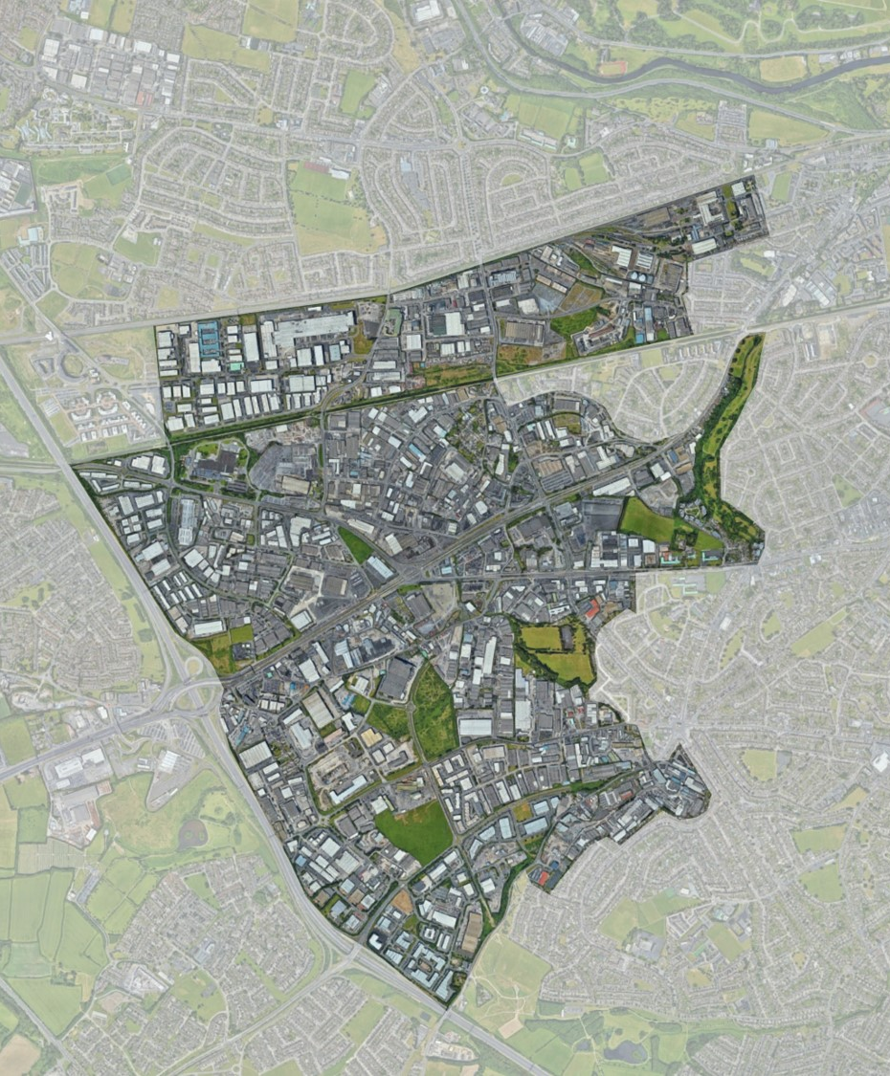
Naas Road Regeneration Plan
National planning policy – compact growth – 50% of housing must be on brownfield sites
Naas road study area – 700 hectares in the SDCC and DC area. ( 440 SDCC)
Phase one of study complete by year end.
A range of development scenarios will be looked at over next 50 years.
Potential to accommodate 70- 80000 People and 50-60,000 jobs.

Slide 46
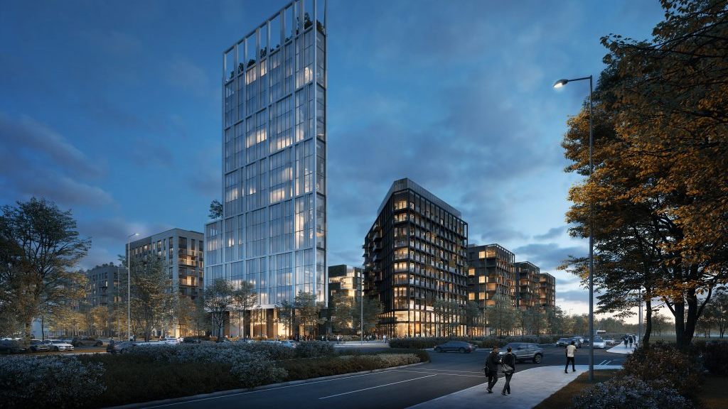
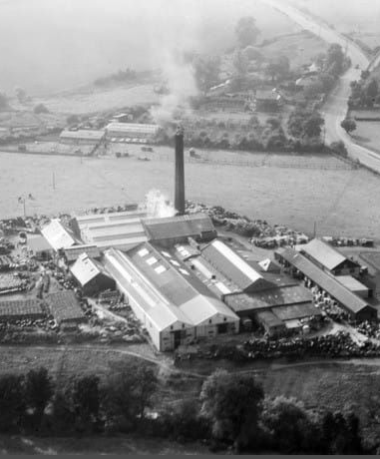
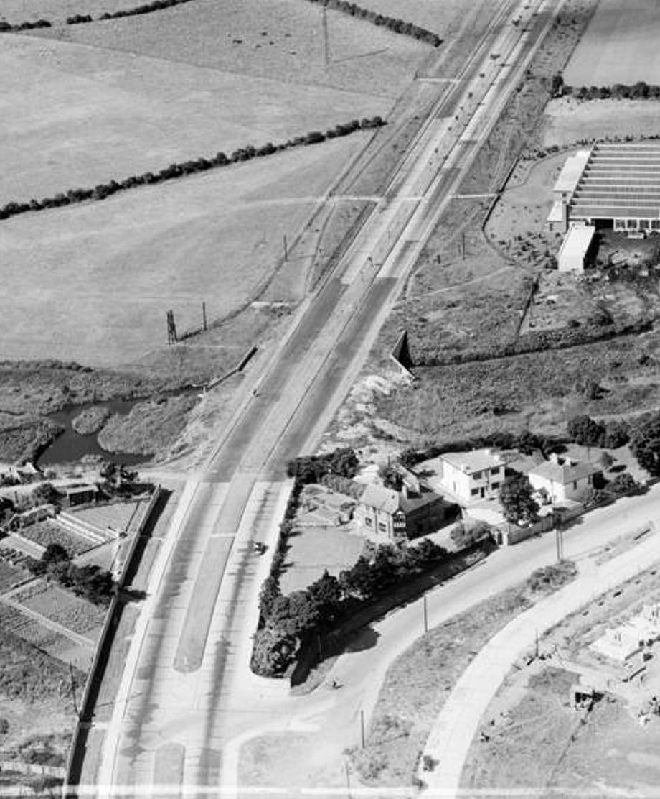
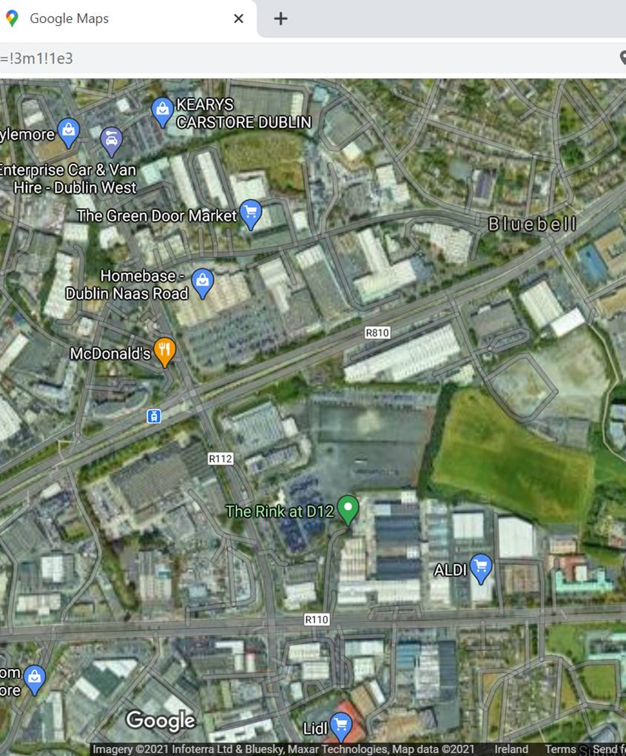
Naas Road Regeneration plan
1940’s - Rural hinterland
1980’s - Industrial heartland
2040’s - New residential led mixed used quarter

Slide 47
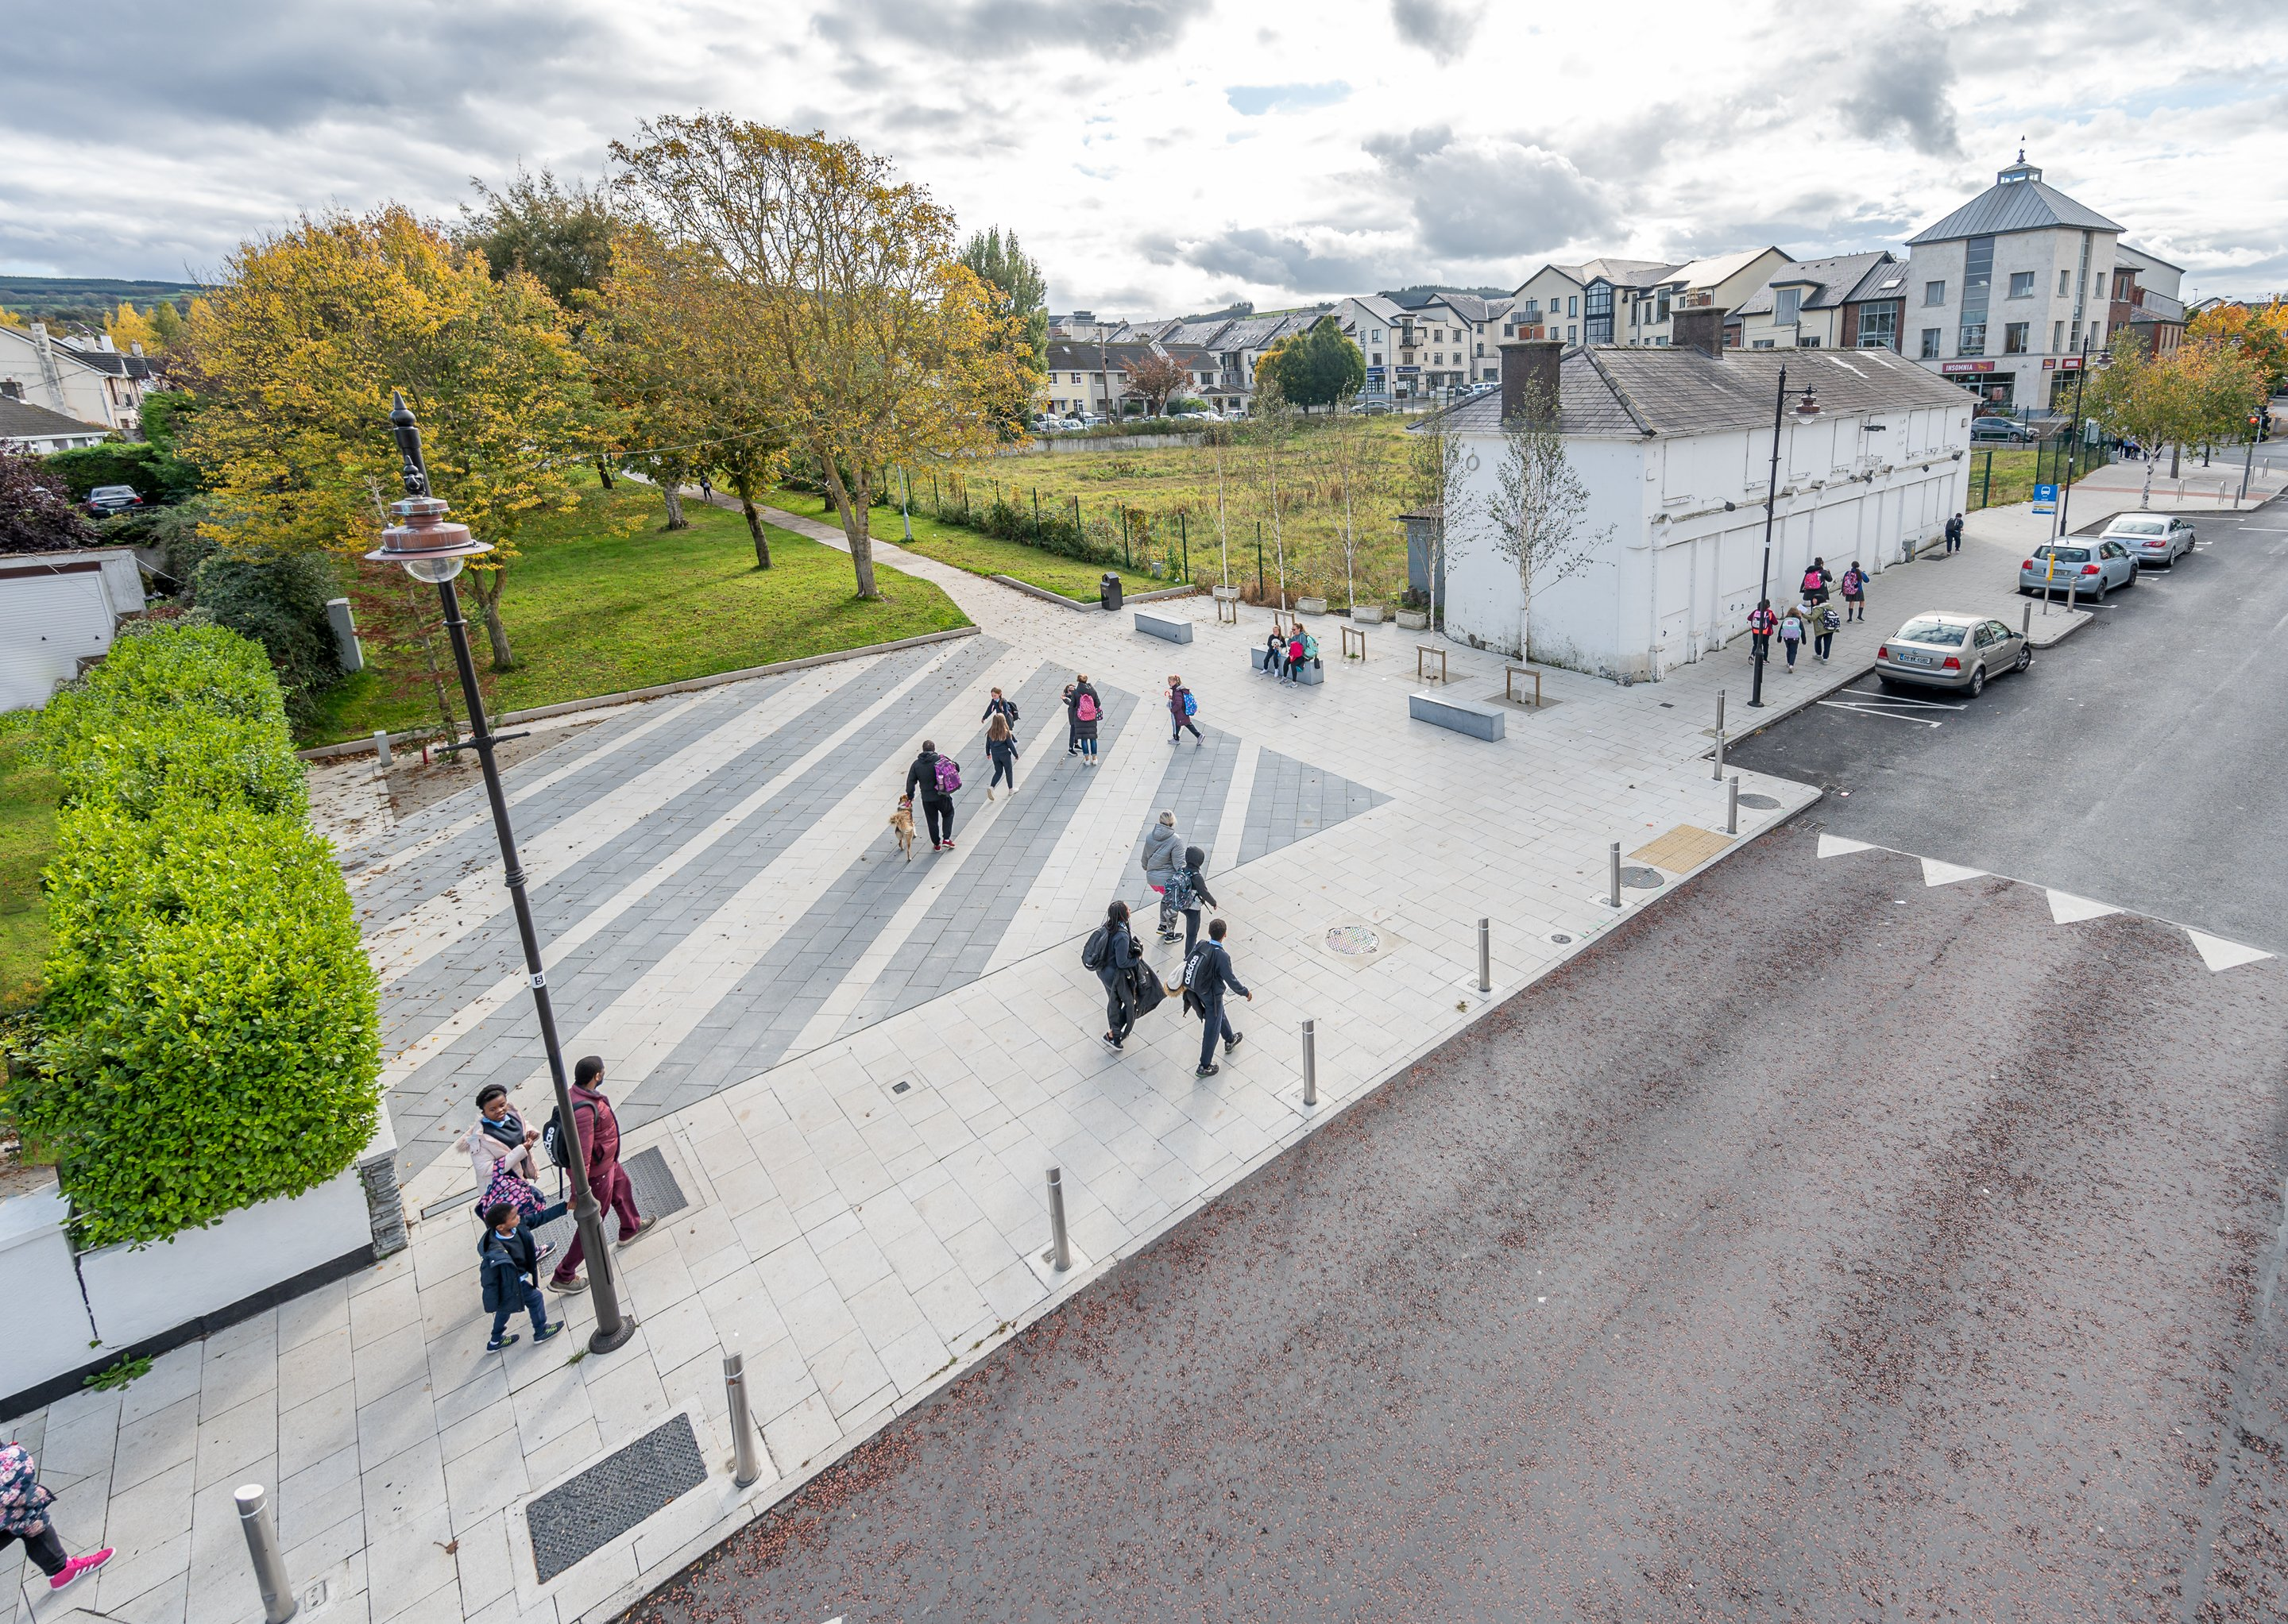
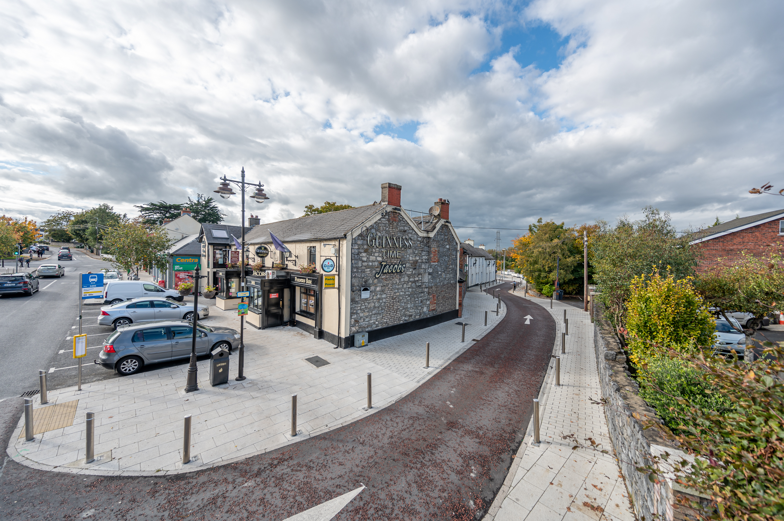
Village renewal
Saggart complete
Lucan at design stage – DESTINATION TOWN
Templeogue – onsite once construction opens
€2m District enhancement scheme – 10 initially starting with Castletymon, Rosemount, Neilston and Bawnogue.
Clondalkin village Center – redesign this year.

Slide 48
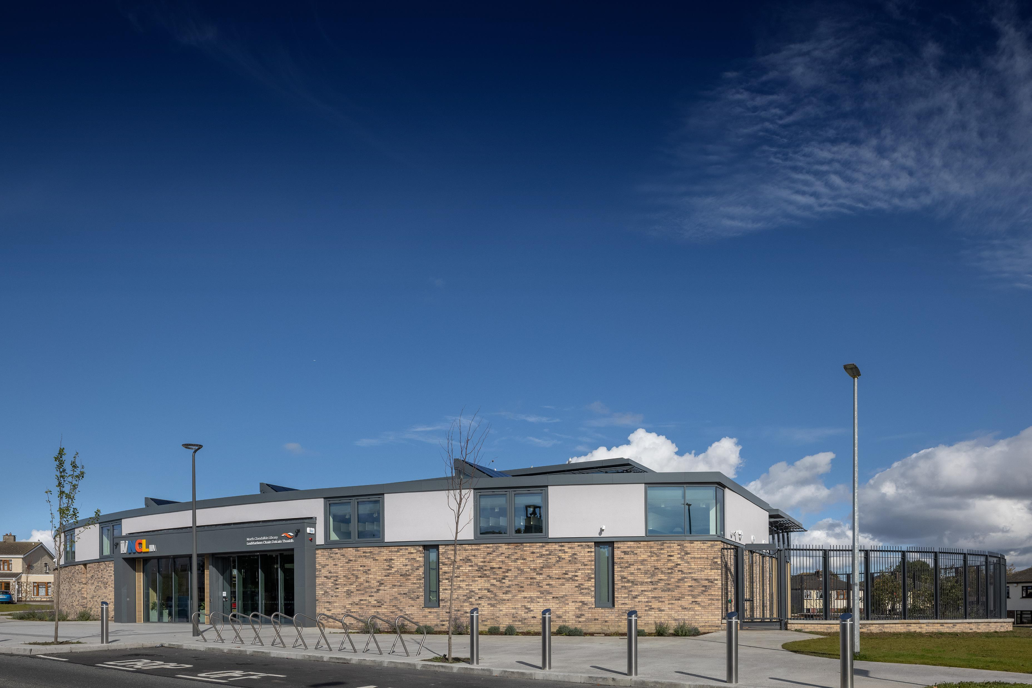
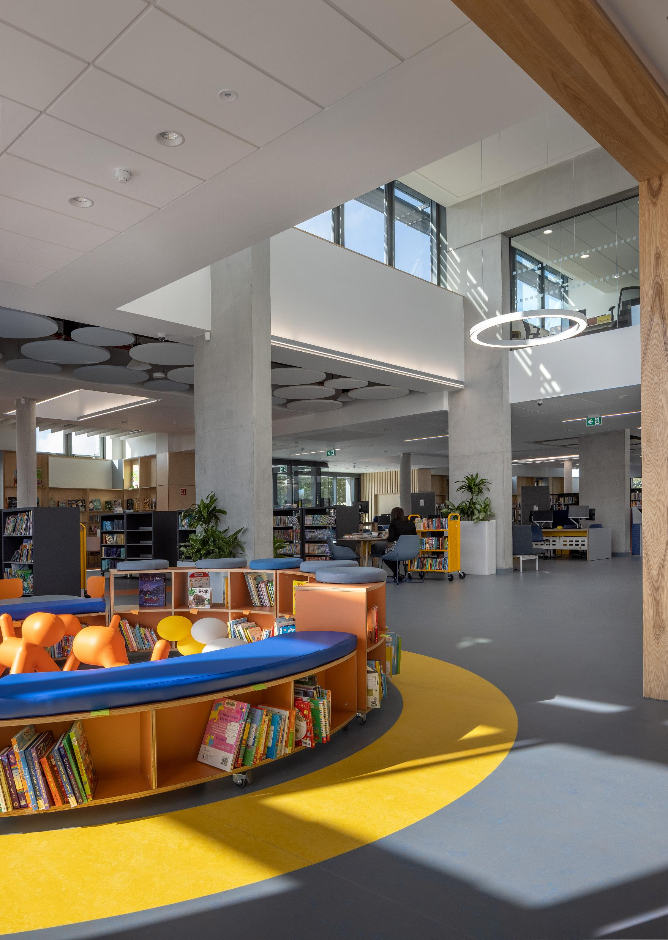
North Clondalkin Library

Slide 49
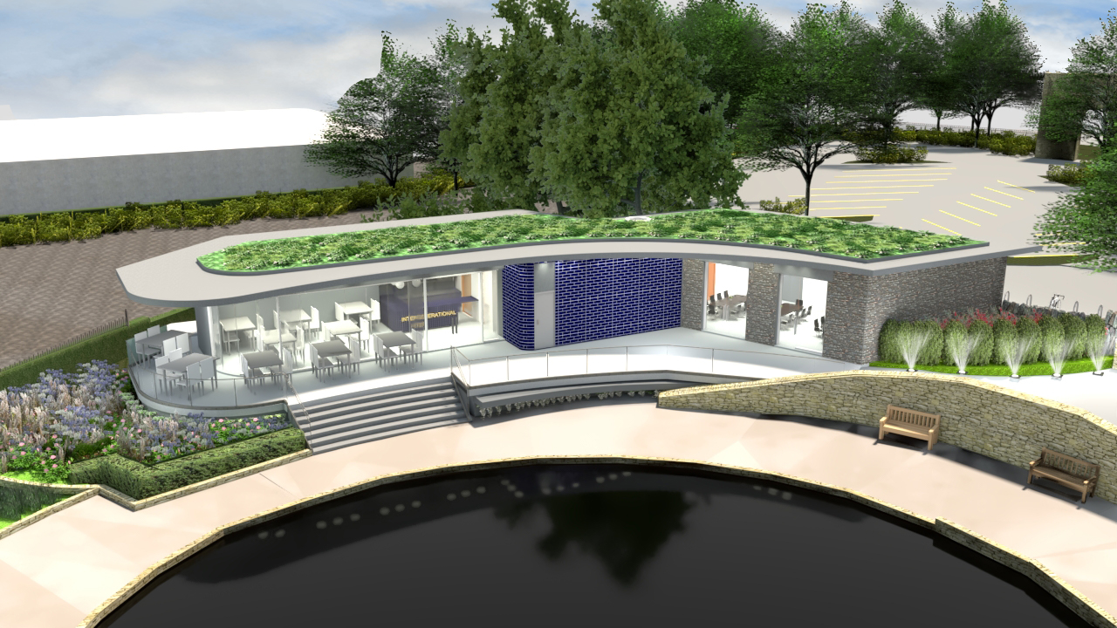
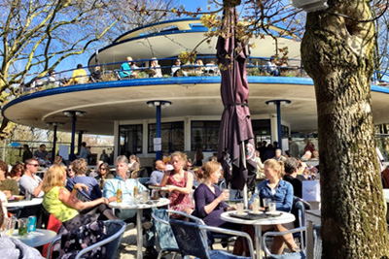


Templeogue Intergenerational Centre

Slide 50

Kiltipper pitches

Slide 51


Killinardin park
€2.5m investment
New playing fields , leisure walks , playground, pump track , outdoor gym , biodiversity areas , cycle track
Connections to Sean Walsh park and onto dodder valley
Potential connections back to jobstwon and butler McGee park.

Slide 52


Canal loop greenway

Slide 53


Dodder Valley park
3 pedestrian and cycle bridges. Bridges link Tallaght, Firhouse, Tempelogue and Rathfarnham
Completion plus interlinks 2021
€8m funding 2021

Slide 54



Other Parks
Grange castle pocket park €1m – complete
Adamstown parks €14m Tandy’s lane complete. Airlie park underway.
Corkagh park €5m – Design team appointed

Slide 55



Climate action
Newsletter – sign up !
Achieved our energy saving target of 33% one year early – 34.4%
Biodiversity action plan adopted
Green flags – council parks.
9 water stations – 50,000 plastic bottles saved in a year.
Tallaght district heating scheme.
Public lighting – over 10,000
Flood alleviation schemes .
Decarbonized zone – next up !

Slide 56

Grange castle West Business park extension.
500 additional acres – 5000 jobs minimum
Good interest - provisional agreement for sale to Lens Media
Access road €10m – under construction

Slide 57


Projects paused
Housing including 1000 house scheme in kilcarbery
Lucan pool
Roads and cycle projects
Rathfarnham castle
Dublin mountains project
Any many more

Slide 58



Praise from others !
Our parks – 5 green flags
Our playgrounds – nominated for european innovation in politics award.
Our enterprise supports a national winner – will represent Ireland in Europe
Recording studio – public service innovation award
Tallaght central – Grade A litter mark.
Remote waste facility inspections – LGMA national recognition for innovation .

Slide 59

A reminder - Think before you Click!
When it comes to email;
  Do you know the sender?
  Is the email part of a known and expected activity?
  Are you expecting to receive an attachment or link?
If the answer to any or all of the above is “no” then you may be being phished
(don’t click on the links or attachment if present)

Slide 60
South Dublin County Council
Ethical Phishing Campaign
in Numbers
1117
141
125
118
733
384 Total [34%] Opened
4.9% (55) targets reported the phishing email
243 Total [22%] Clicked Link
Targets
No Action
Opened Email
Clicked Link
Data Submitted

Slide 61
Changes from 2018 - 2020
Click Through %
2018
46.9%
2020
22%
Increased the depth of the audit
to include 1117 targets in the current
campaign (869 targets in 2018)

Slide 62
Questions
QI - was wondering whether you could please rise the issue of the water and drainage staff. We have been left in the dark for to long. Council need to start re deploying us true out the other sections.
Q2 - just have a question about the above re: air circulation in the office as restrictions begin to ease and more people return to the office to work. Are there plans to bring in air purifiers etc as we know now that Covid is air borne and fresh air is as important as clean hands!
Q3 - Are there plans to introduce an online payments system, whereby tenants can pay rent and customers can pay for Planning, fines, Rates etc. Currently, with the offices closed to the public, tenants and customers can only pay over the phone. With only two card machines in the Tallaght office currently, not all payments can be processed in a timely manner

Slide 63

Corporate vision
“To make our county a vibrant and inclusive place for the people who live, visit, work, and do business here, now and for the future”.

Slide 64

Thank you and well done !

